Slide 1
Space Race With Data Science
Coulson Thabo Kgathi
3 March 2023

Slide 2
Outline
Executive Summary
Introduction
Methodology
Results
Conclusion
Appendix

Slide 3
Executive Summary
Summary of methodologies
SpaceX Data Collection using SpaceX API
SpaceX Data Collection with Web Scraping
SpaceX Data Wrangling
SpaceX Exploratory Data Analysis using SQL
Space-X EDA DataViz Using Python Pandas and Matplotlib
Space-X Launch Sites Analysis with Folium-Interactive Visual
Analytics and PlotyDash
SpaceX Machine Learning Landing Prediction
Summary of all results
EDA results
Interactive Visual Analytics and Dashboards
Predictive Analysis(Classification)

Slide 4
Introduction
Project background and context
SpaceX advertises Falcon 9 rocket launches on its website with a cost of 62 million dollars; other providers cost upward of 165 million dollars each, much of the savings is because SpaceX can reuse the first stage. Therefore if we can determine if the first stage will land, we can determine the cost of a launch. This information can be used if an alternate company wants to bid against SpaceX for a rocket launch.
Problems you want to find answers
In this capstone, we will predict if the Falcon 9 first stage will land successfully using data from Falcon 9 rocket launches advertised on its website.

Slide 5
Methodology
Data collection methodology:
Describes how data sets were collected
Perform datawrangling
Describes how data were processed
Perform exploratory data analysis (EDA) using visualization andSQL
Perform interactive visual analytics using Folium andPlotlyDash
Perform predictive analysis using classification models
How to build, tune, evaluate classification models

Slide 6
Data Collection
How SpaceX Falcon9 data was collected.
Data was first collected using SpaceX API (a RESTful API) by making a get request to the SpaceX API. This was done by first defining a series helper functions that would help in the use of the API to extract information using identification numbers in the launch data and then requesting rocket launch data from the SpaceX API url.
Finally to make the requested JSON results more consistent, the SpaceX launch data was requested and parsed using the GET request and then decoded the response content as a Jsonresult which was then converted into a Pandas data frame.
Also performed web scraping to collect Falcon 9 historical launch records from a Wikipedia page titled List of Falcon 9 and Falcon Heavy launchesof the launch records are stored in a HTML. Using BeautifulSoupand request Libraries, I extract the Falcon 9 launch HTML tablerecordsfrom the Wikipedia page, Parsed the table and converted it into a Pandas data frame

Slide 7
Data Collection: SpaceX API
Data collected using SpaceX API (a RESTful API) by making a get request to the SpaceX API then requested and parsed the SpaceX launch data using the GET request and decoded the response content as a Jsonresult which was then converted into a Pandas data frame
GitHub URL of the completed SpaceX API calls notebook:

Slide 8
Data Collection: WebScraping
Performed web scraping to collect Falcon 9 historical launch records from a Wikipedia using BeautifulSoupand request, to extract the Falcon 9 launch records from HTML table of the Wikipedia page, then created a data frame by parsing the launch HTML.
GitHub URL of the completed SpaceX API calls notebook:

Slide 9
Data Wrangling
After obtaining and creating a Pandas DF from the collected data, data was filtered using the BoosterVersioncolumn to only keep the Falcon 9 launches, then dealt with the missing data values in the LandingPadand PayloadMasscolumns. For the PayloadMass, missing data values were replaced using mean value of column.
Also performed some Exploratory Data Analysis (EDA) to find some patterns in the data and determine what would be the label for training supervised models
GitHub URL of the completed SpaceX API calls notebook:

Slide 10
EDA With Data Visualisation
Performed data Analysis and Feature Engineering using Pandas and Matplotlib.i.e.
Exploratory Data Analysis
Preparing Data Feature Engineering
Used scatter plots to Visualize the relationship between Flight Number and Launch Site, Payload and Launch Site, FlightNumberand Orbit type, Payload and Orbit type.
Used Bar chart to Visualize the relationship between success rate of each orbit type
Line plot to Visualize the launch success yearly trend.
GitHub URL of your completed EDA with data visualization notebook,

Slide 11
EDA With Data Visualisation Count..

Slide 12
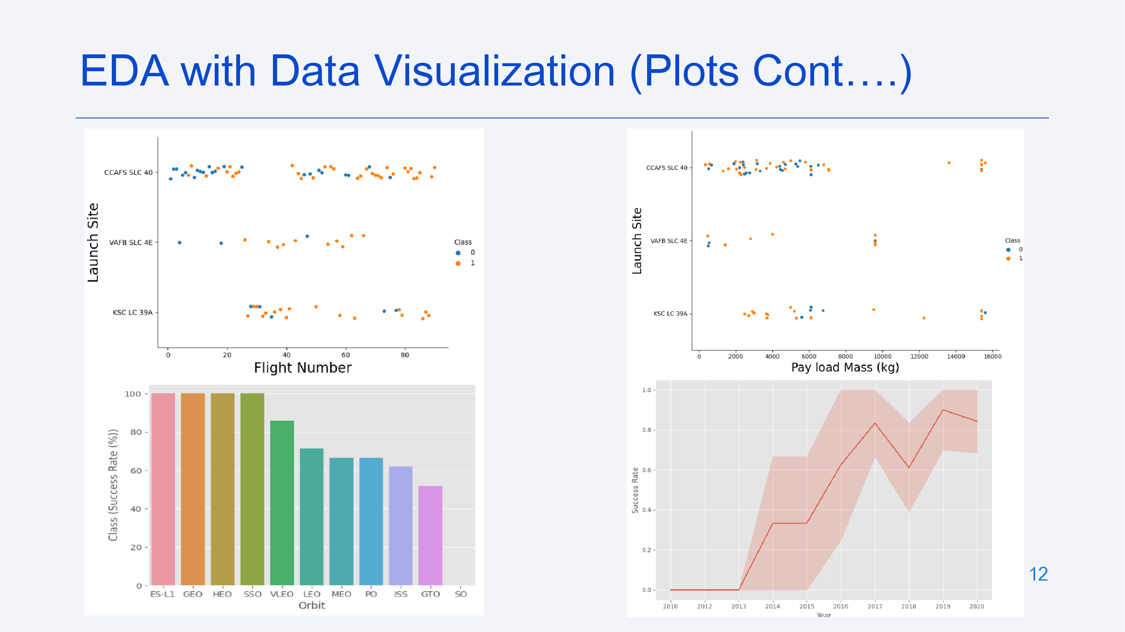

Slide 13
EDC With SQL
The following SQL queries were performed for EDA
Display the names of the unique launch sites in the space mission
Display 5 records where launch sites begin with the string 'CCA‘
Display the total payload mass carried by boosters launched by NASA (CRS)
Display average payload mass carried by booster version F9 v1.1
List the date when the first successful landing outcome in ground pad was achieved.

Slide 14
EDC With SQL Count…
List the names of the boosters which have success in drone ship and have payload mass greater than 4000 but less than 6000 (%sqlSELECT DISTINCT Booster_Version, Payload FROM SPACEXTBL WHERE "Landing _Outcome" = "Success (drone ship)" AND PAYLOAD_MASS__KG_ > 4000 AND PAYLOAD_MASS__KG_ < 6000;)
List the total number of successful and failure mission outcomes
GitHub URL of your completed EDA with SQL notebook:

Slide 15
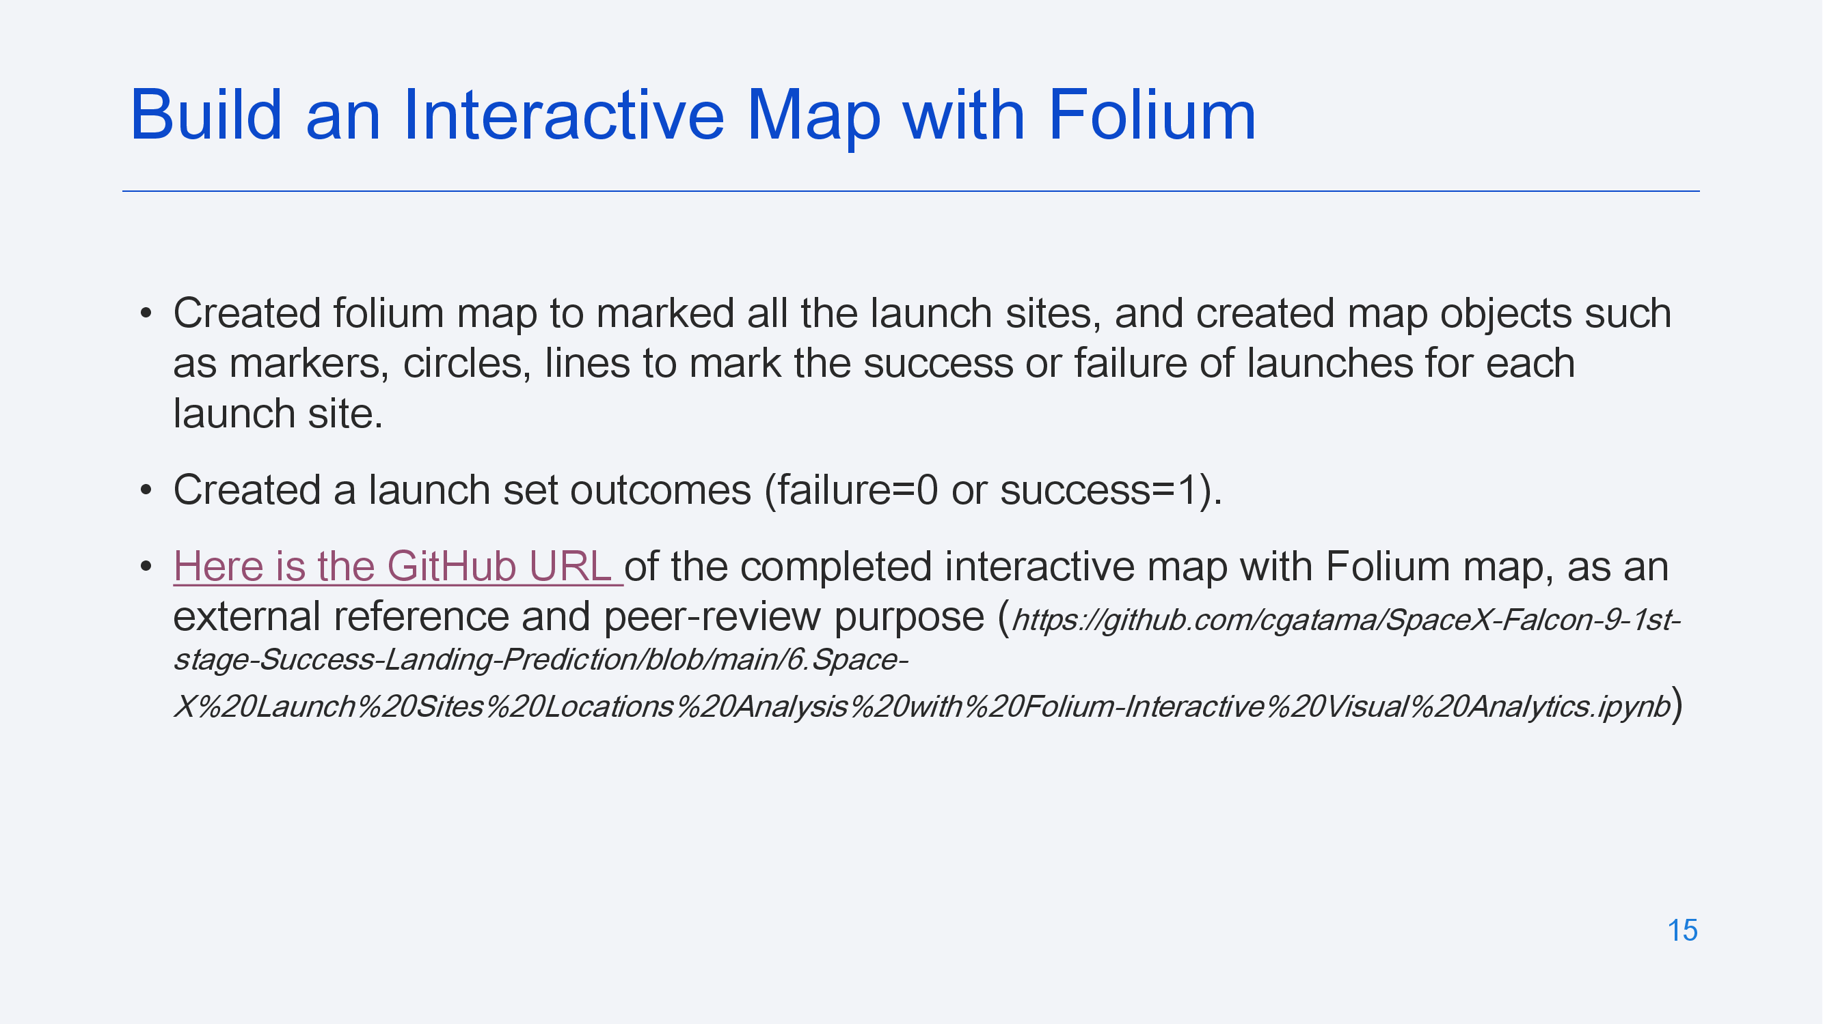

Slide 16
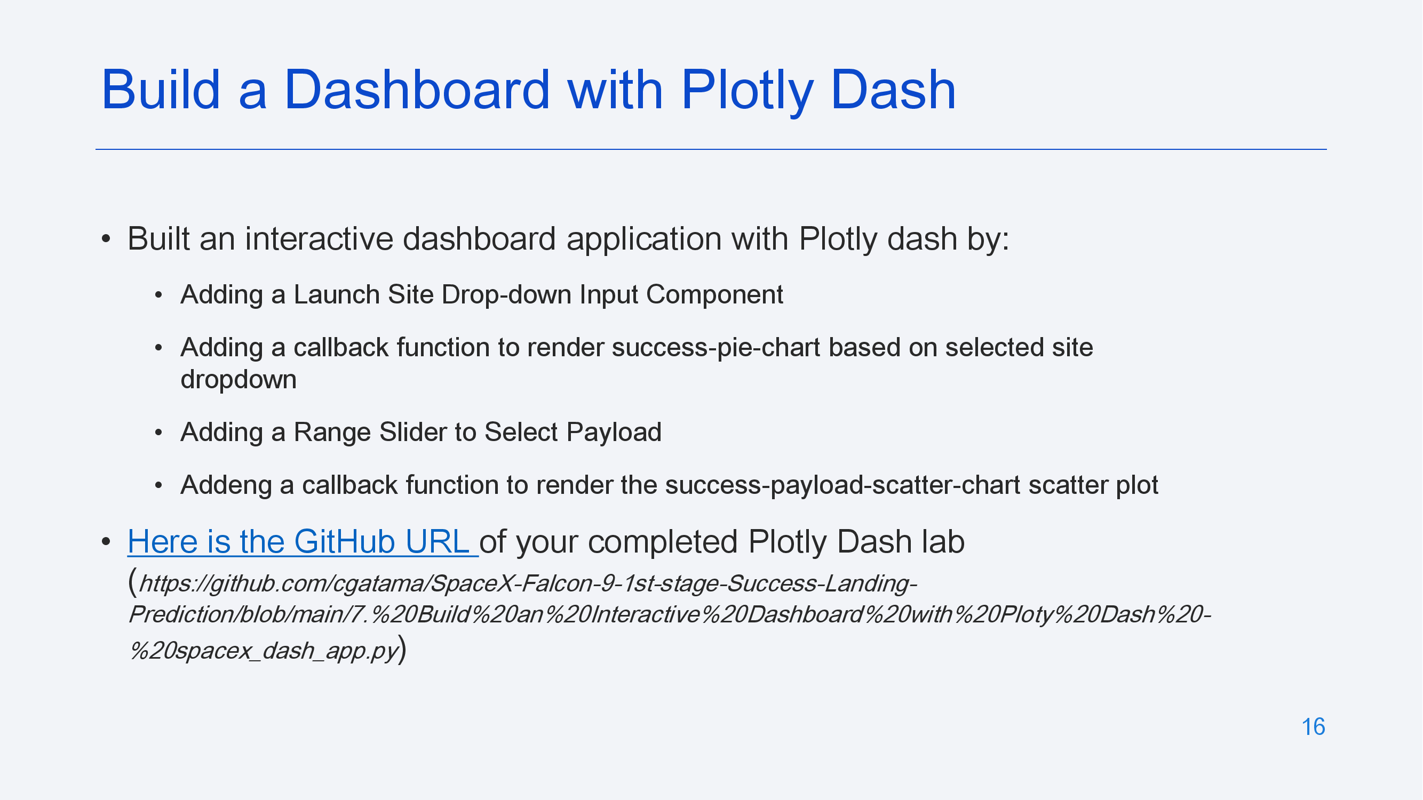

Slide 17
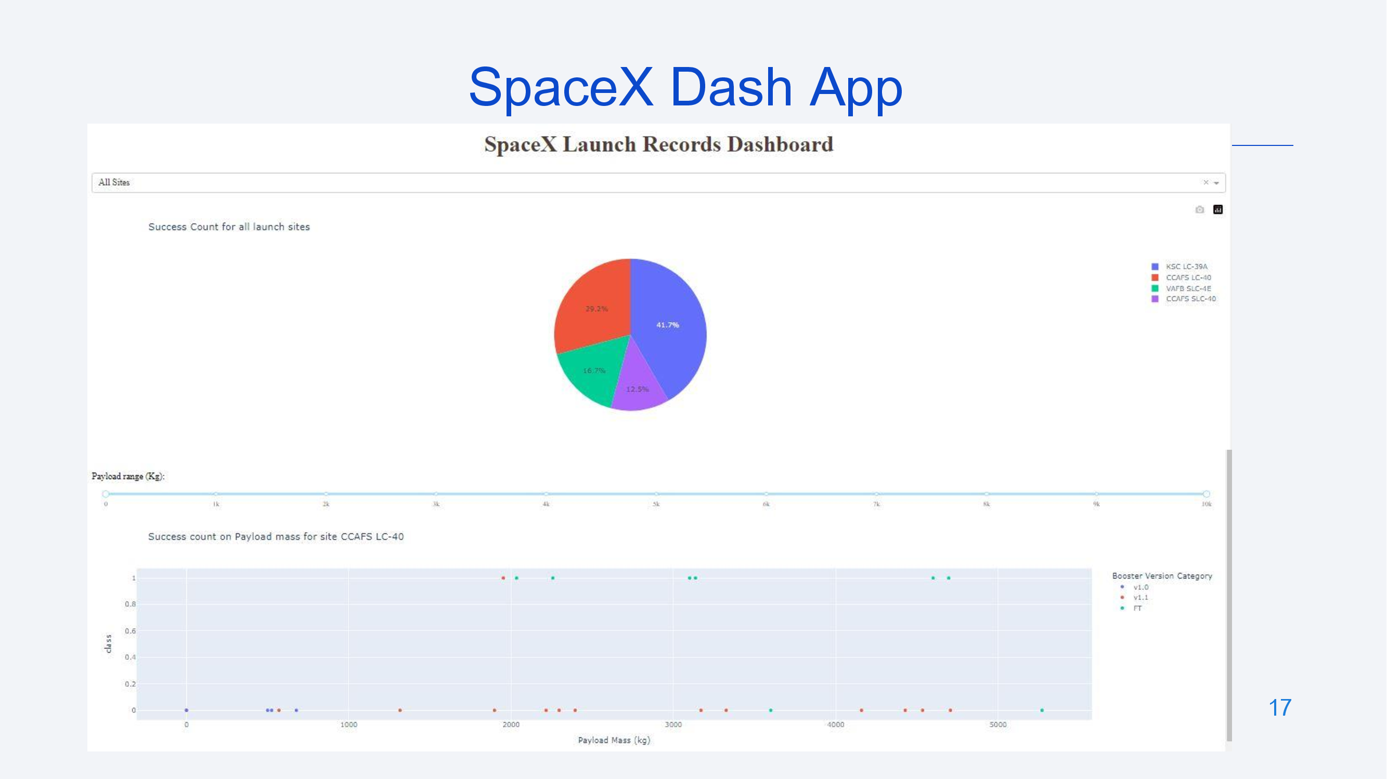

Slide 18
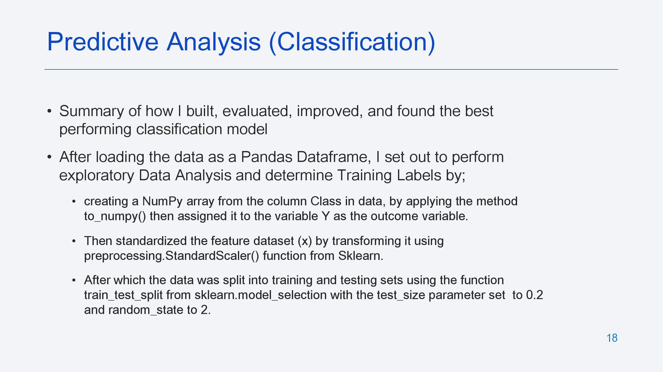

Slide 19
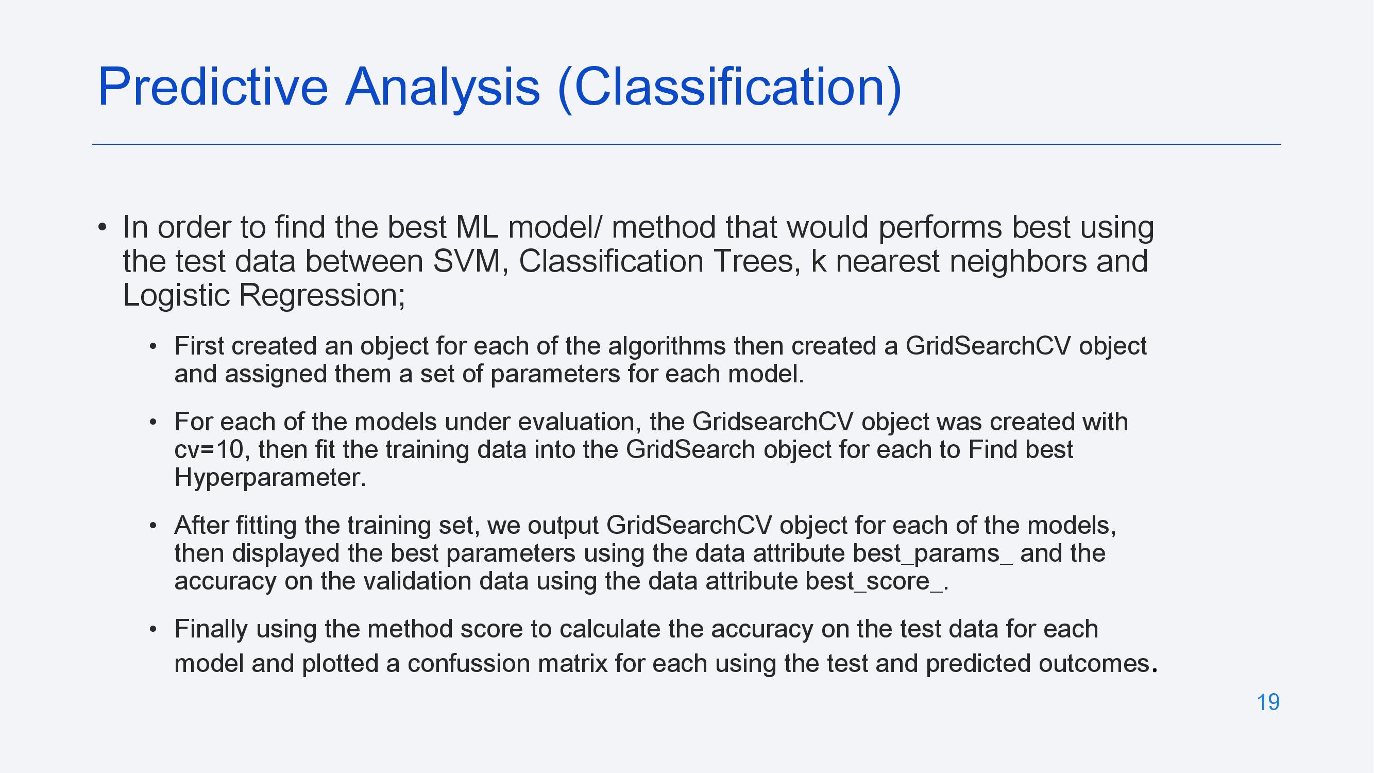

Slide 20
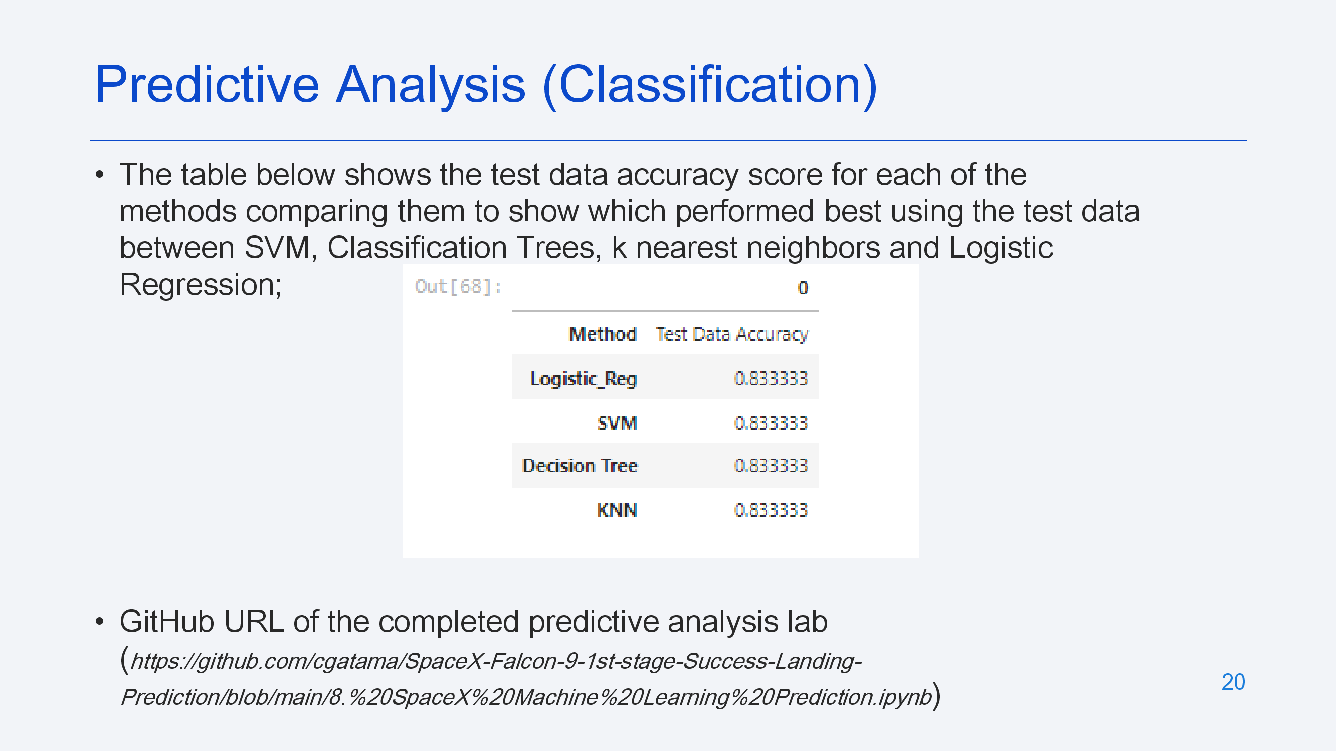

Slide 21
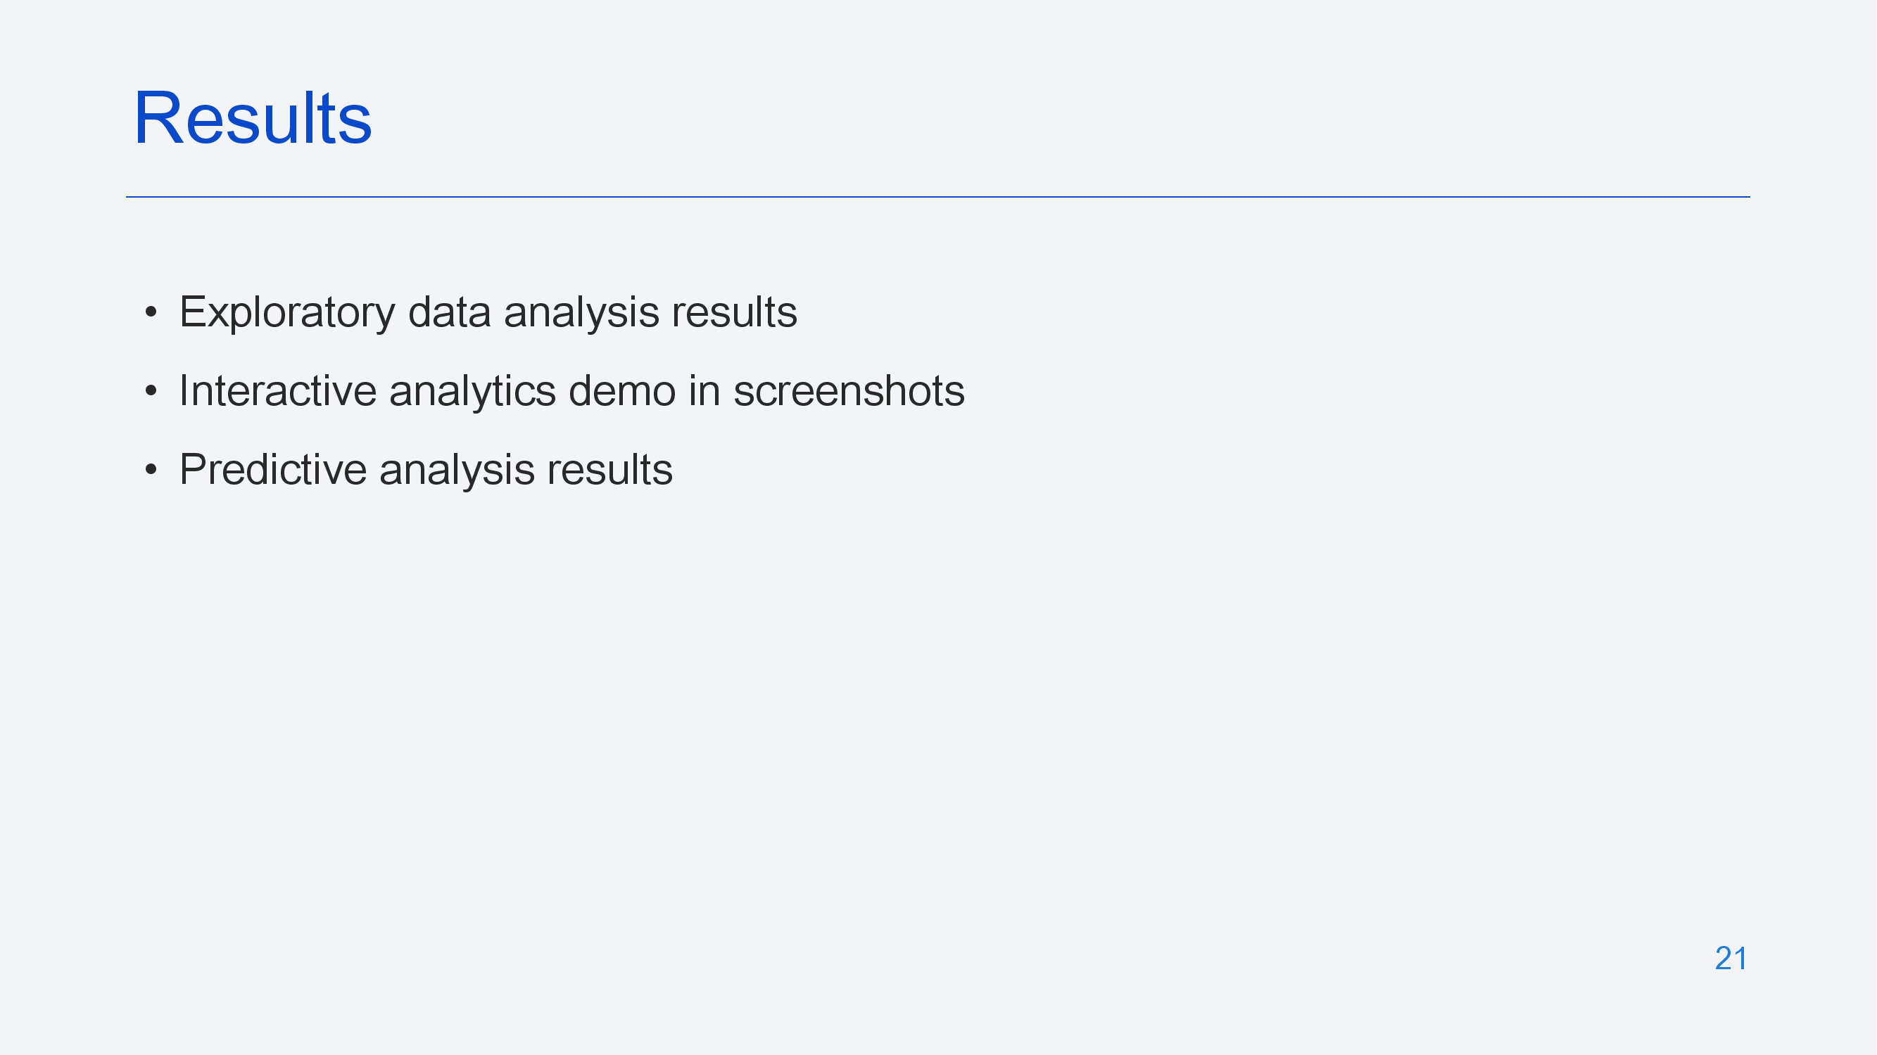

Slide 22
Insights drawn from EDC

Slide 23
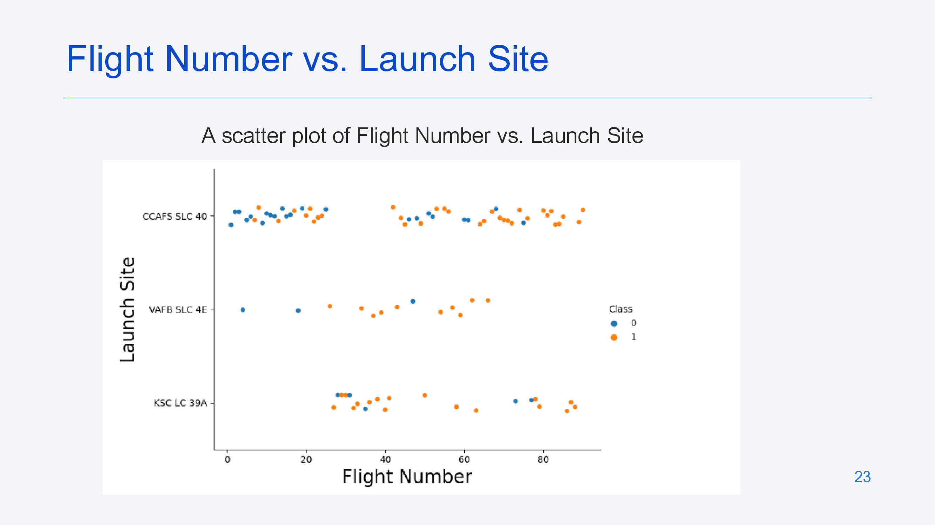

Slide 24
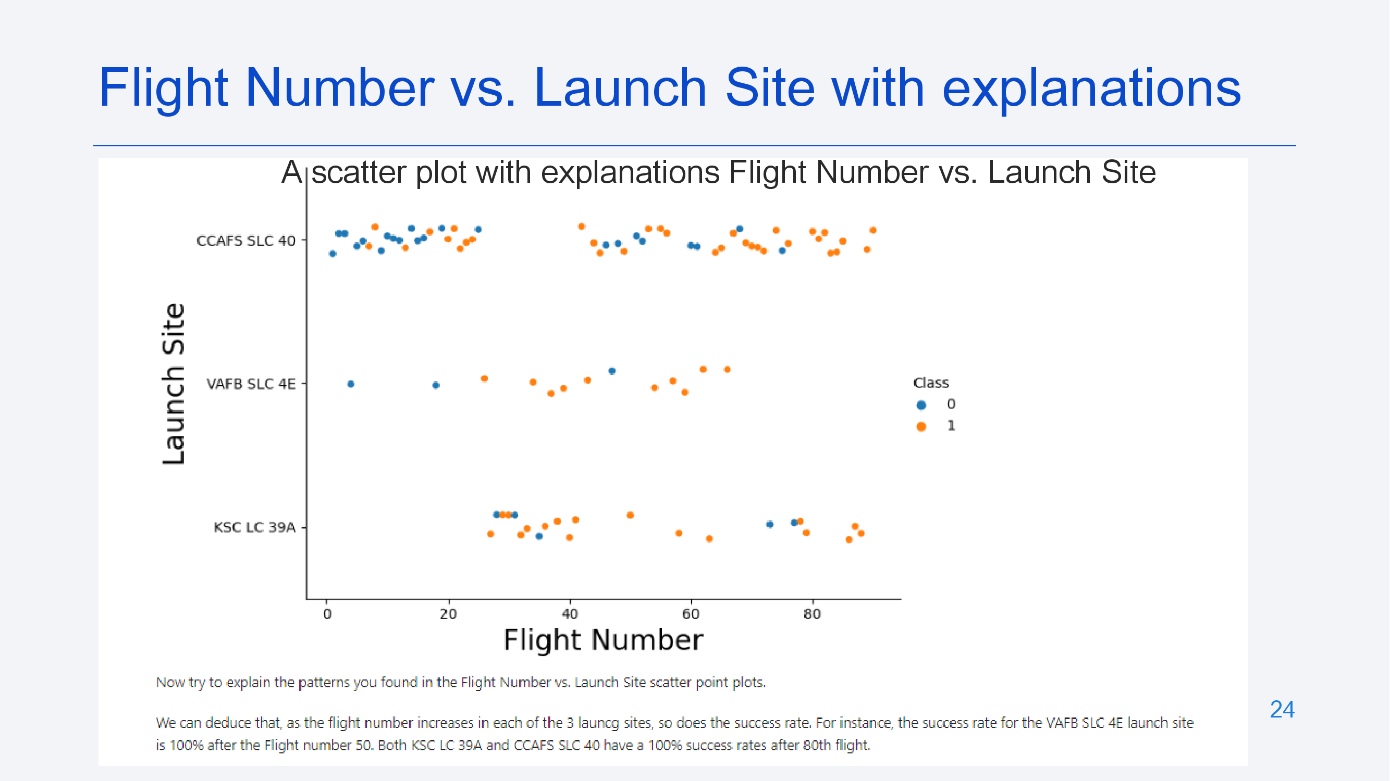

Slide 25
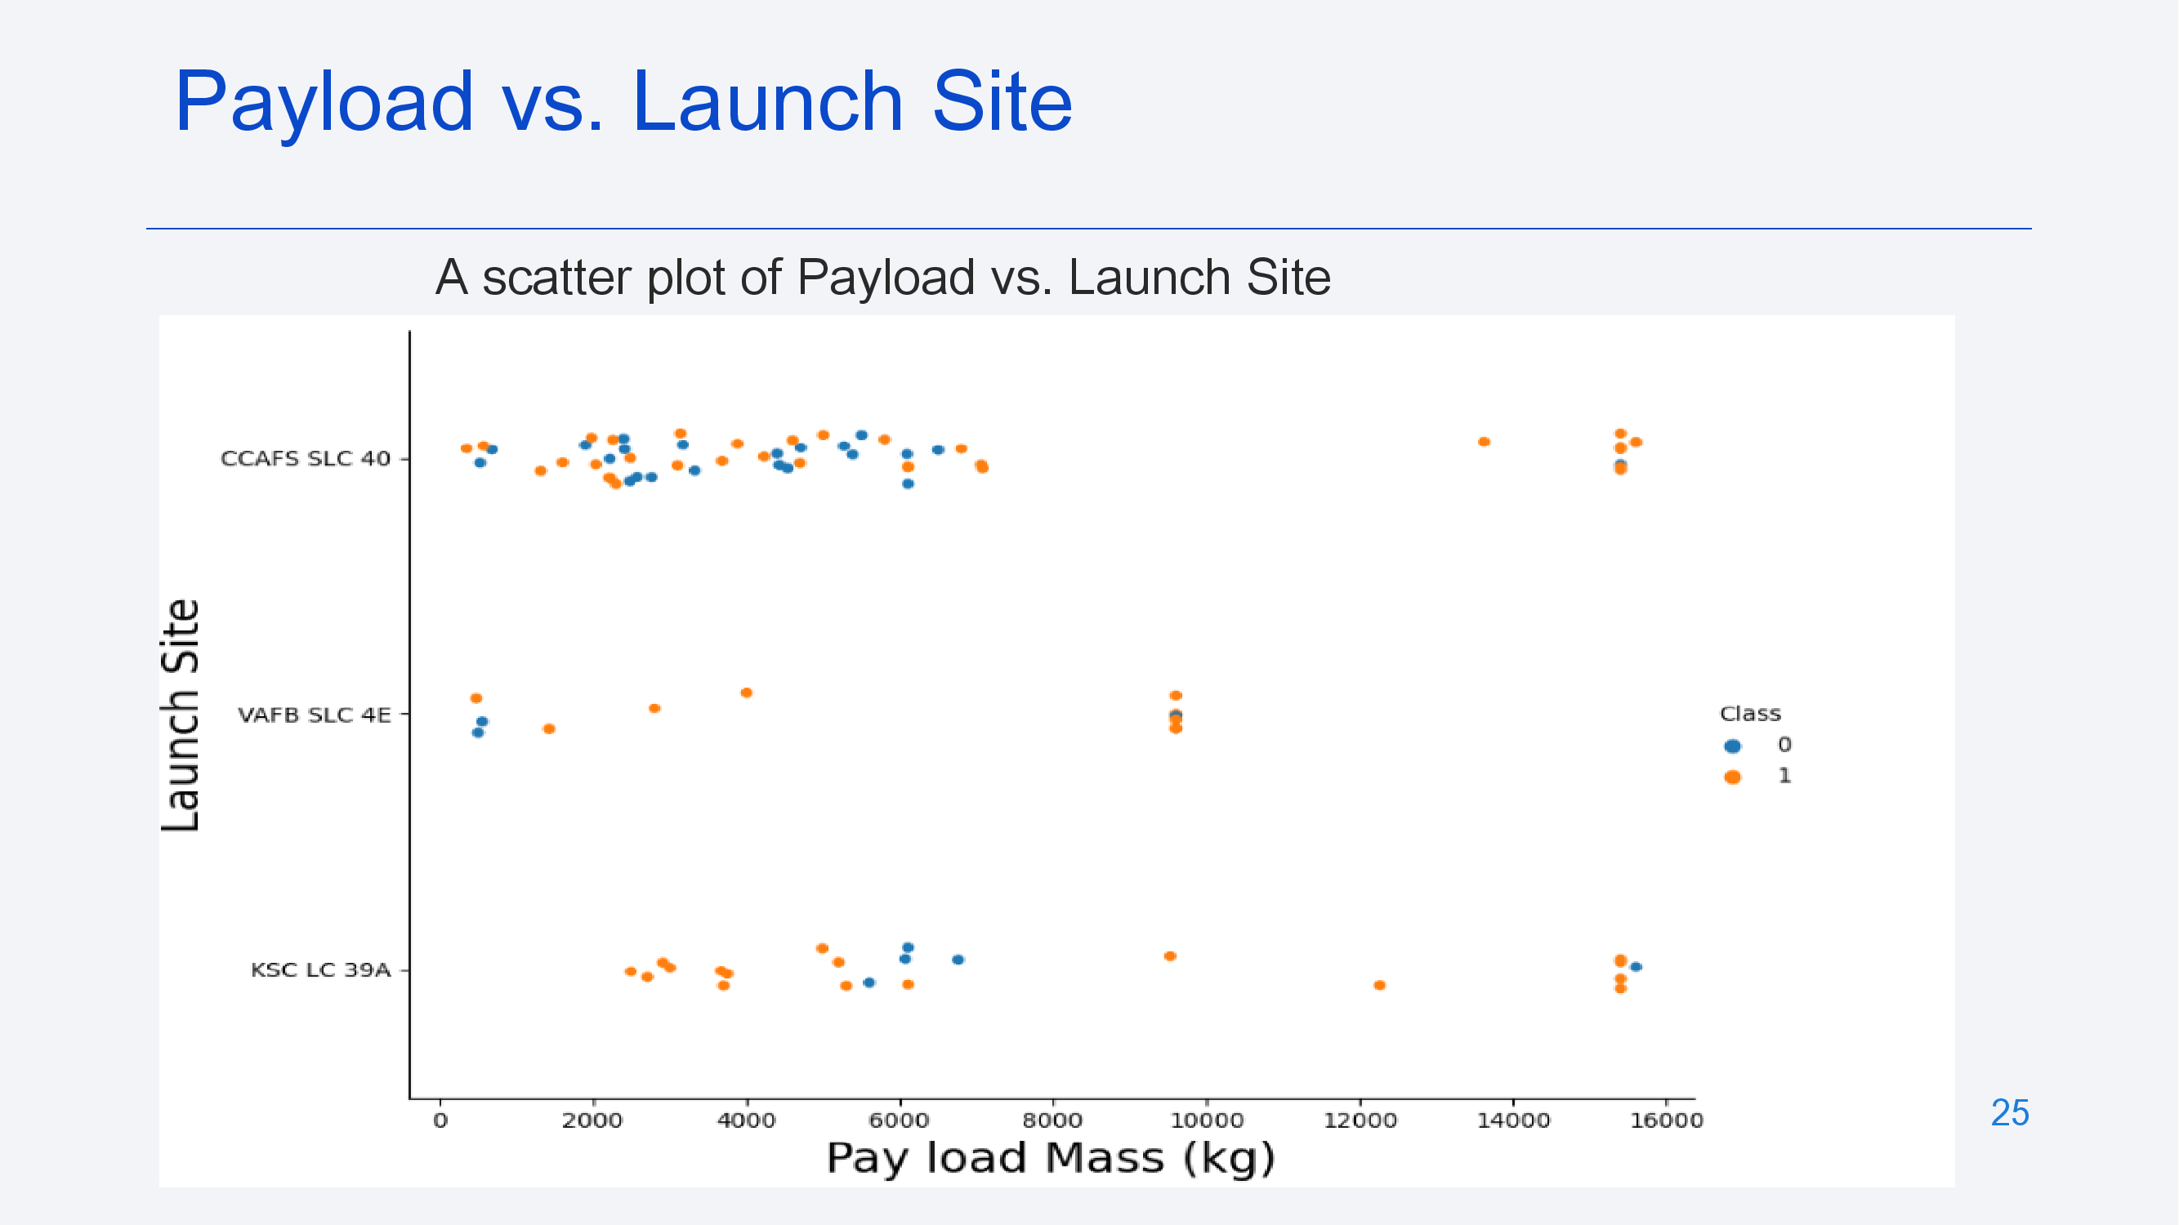

Slide 26
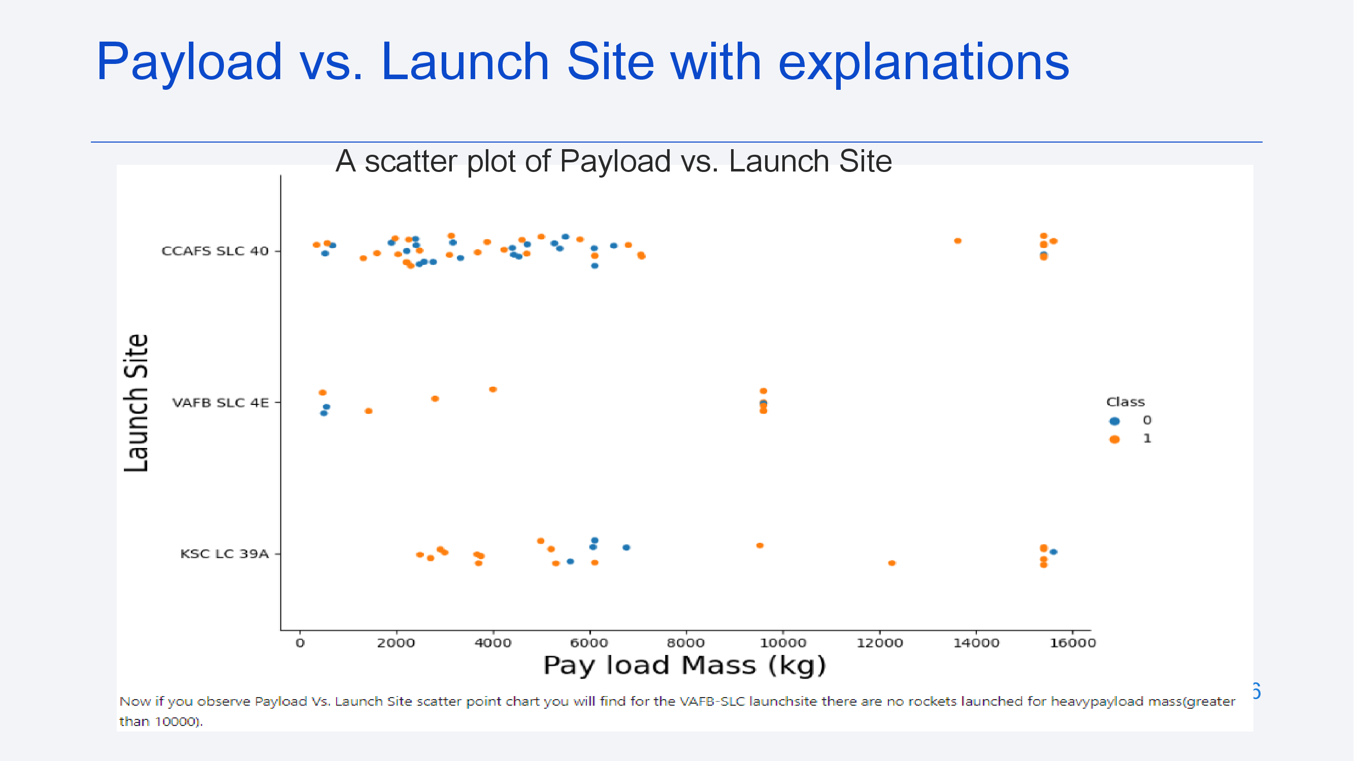

Slide 27
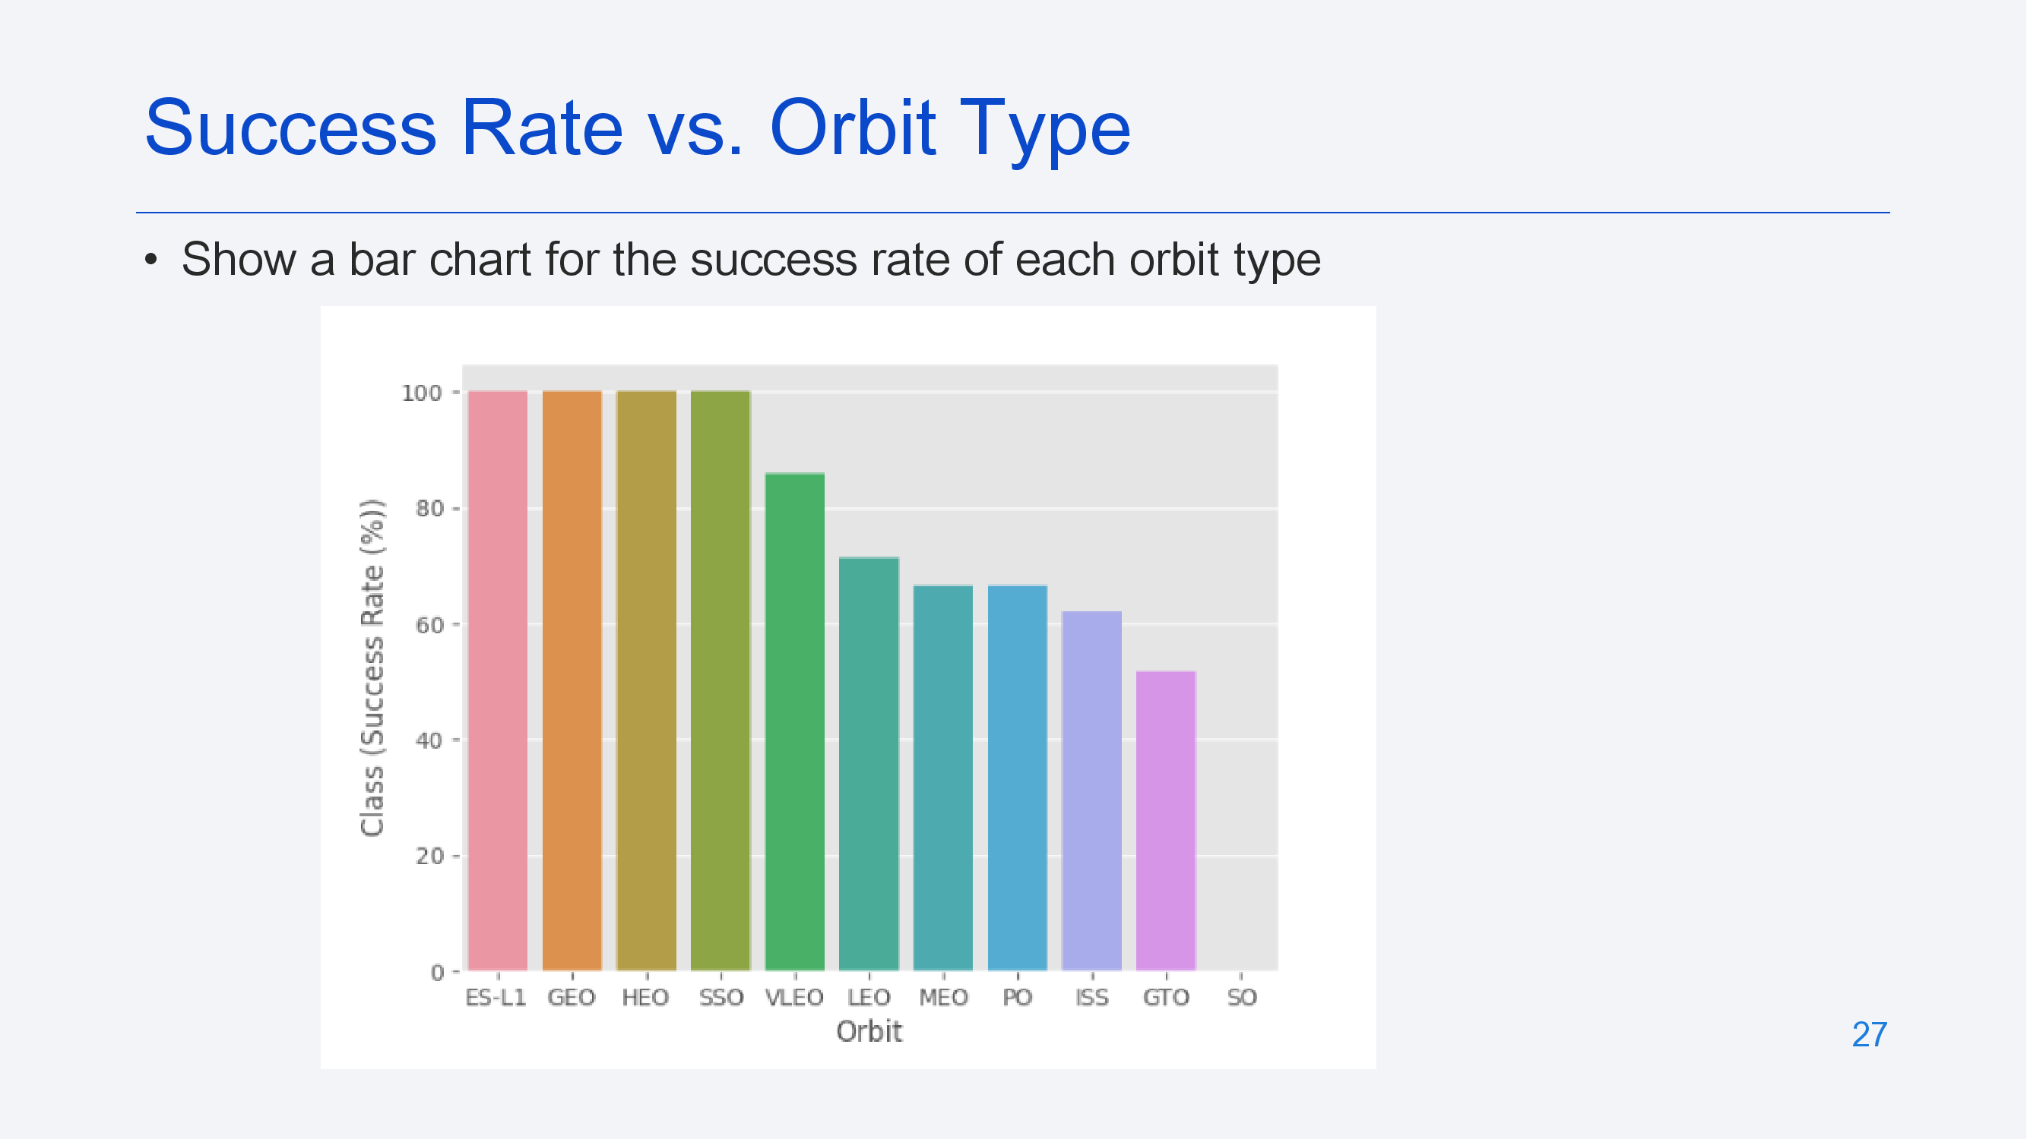

Slide 28
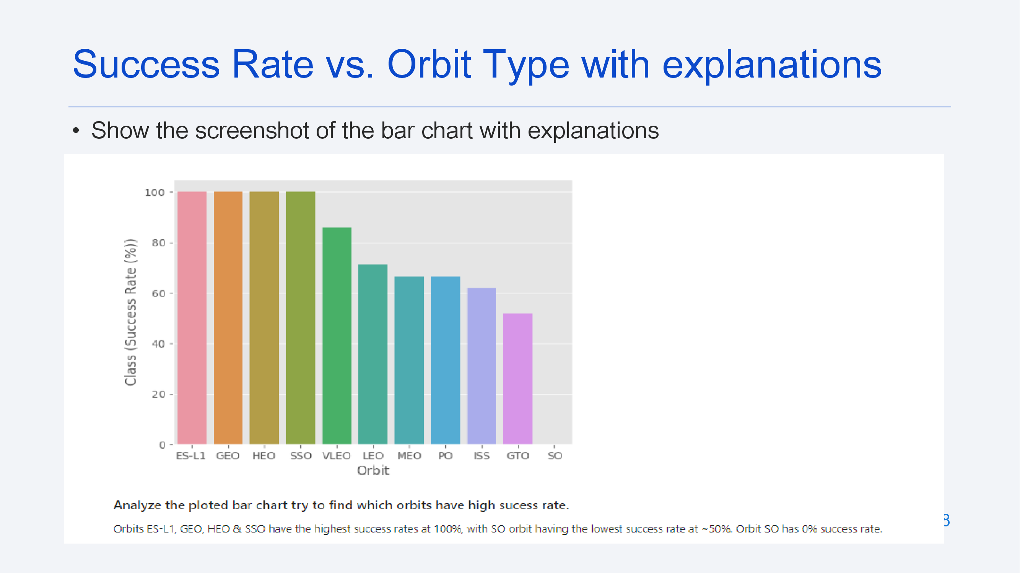

Slide 29
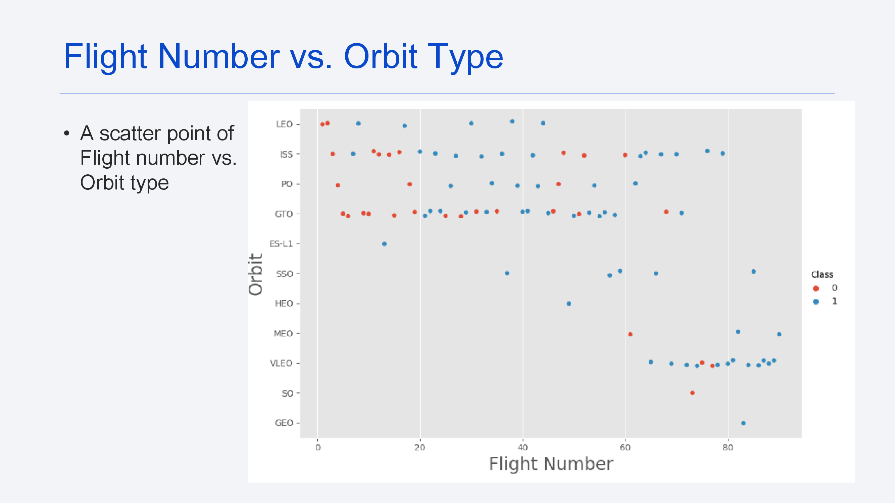

Slide 30
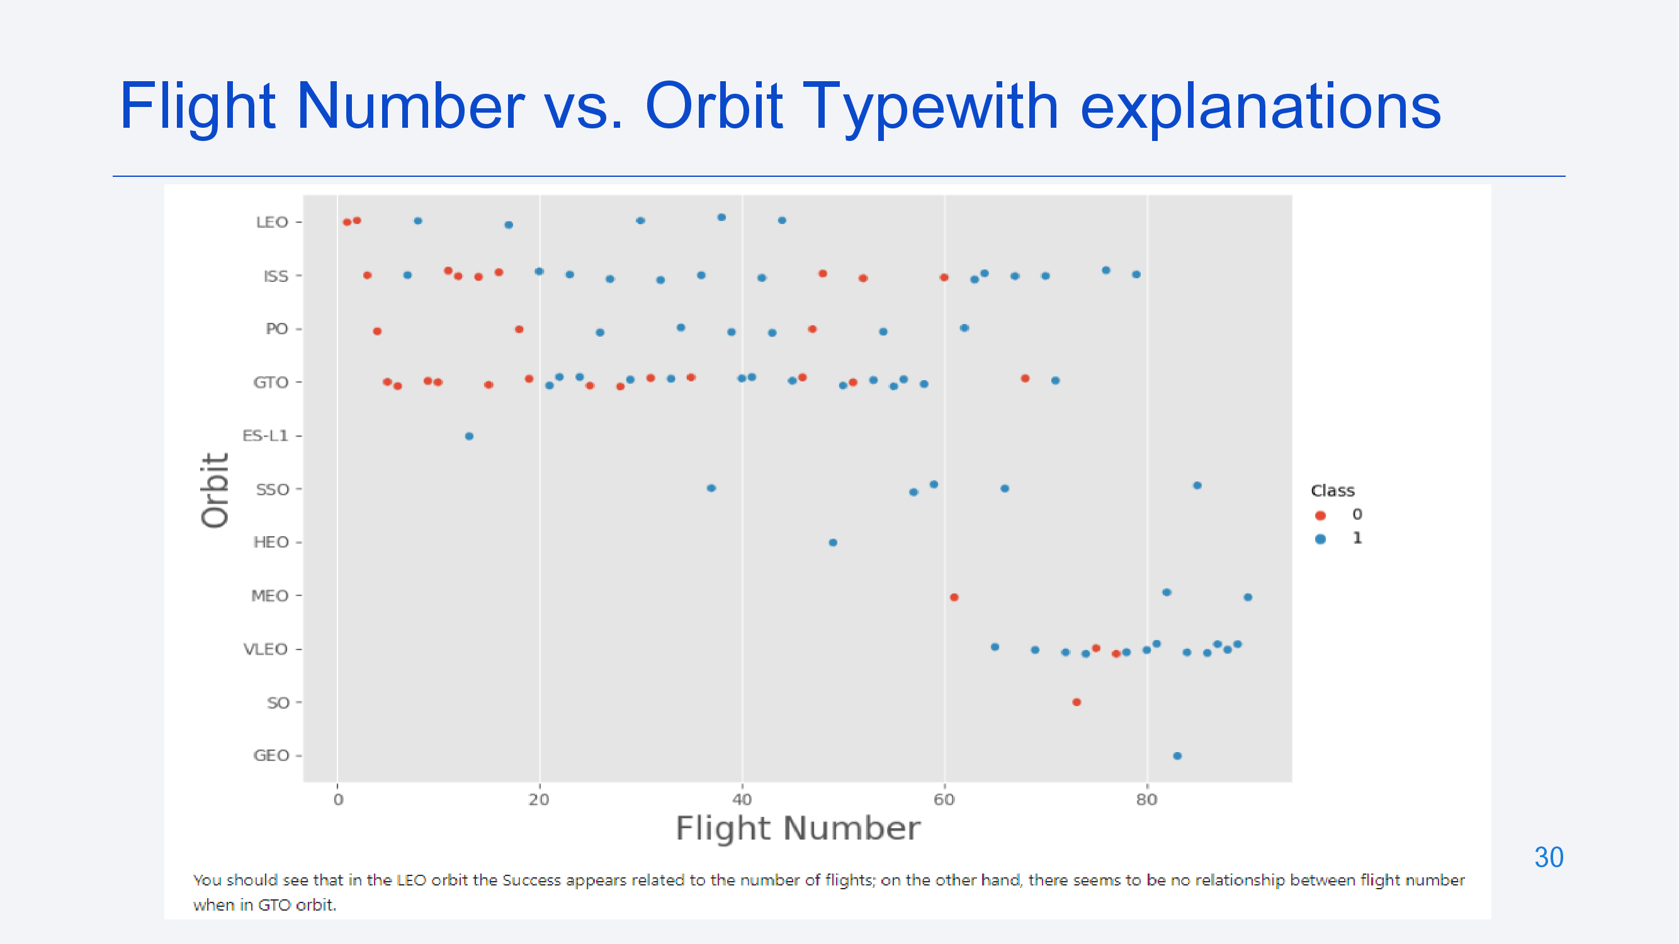

Slide 31
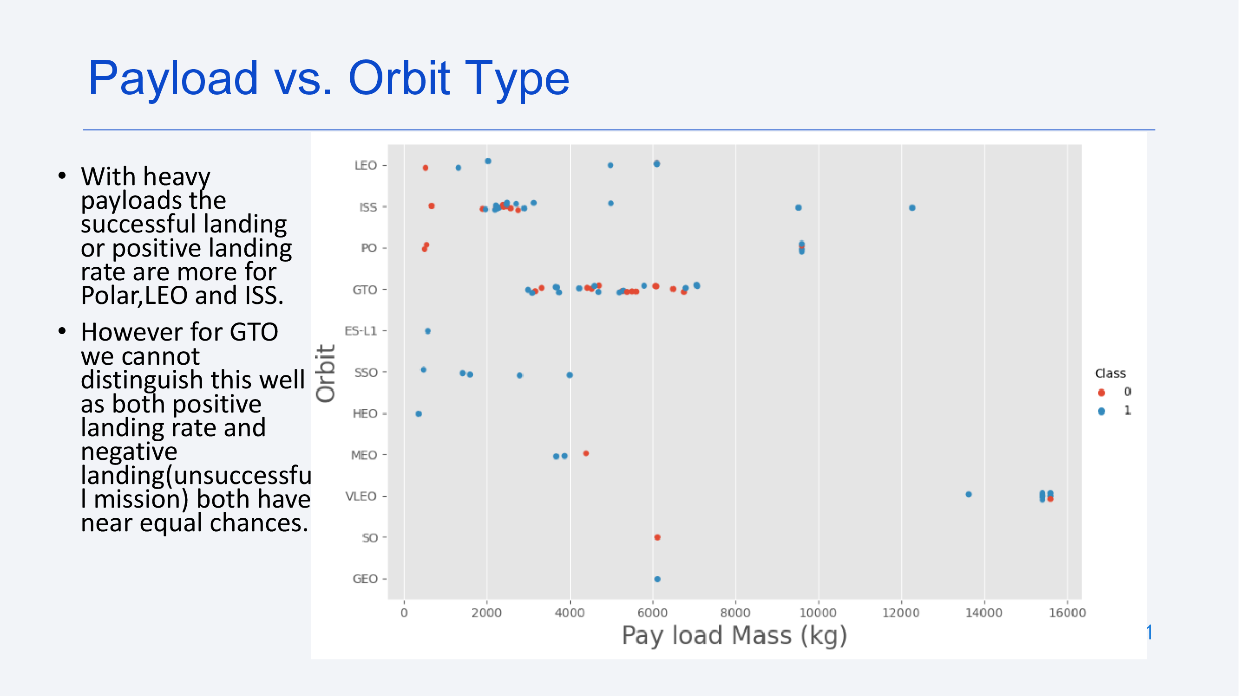

Slide 32
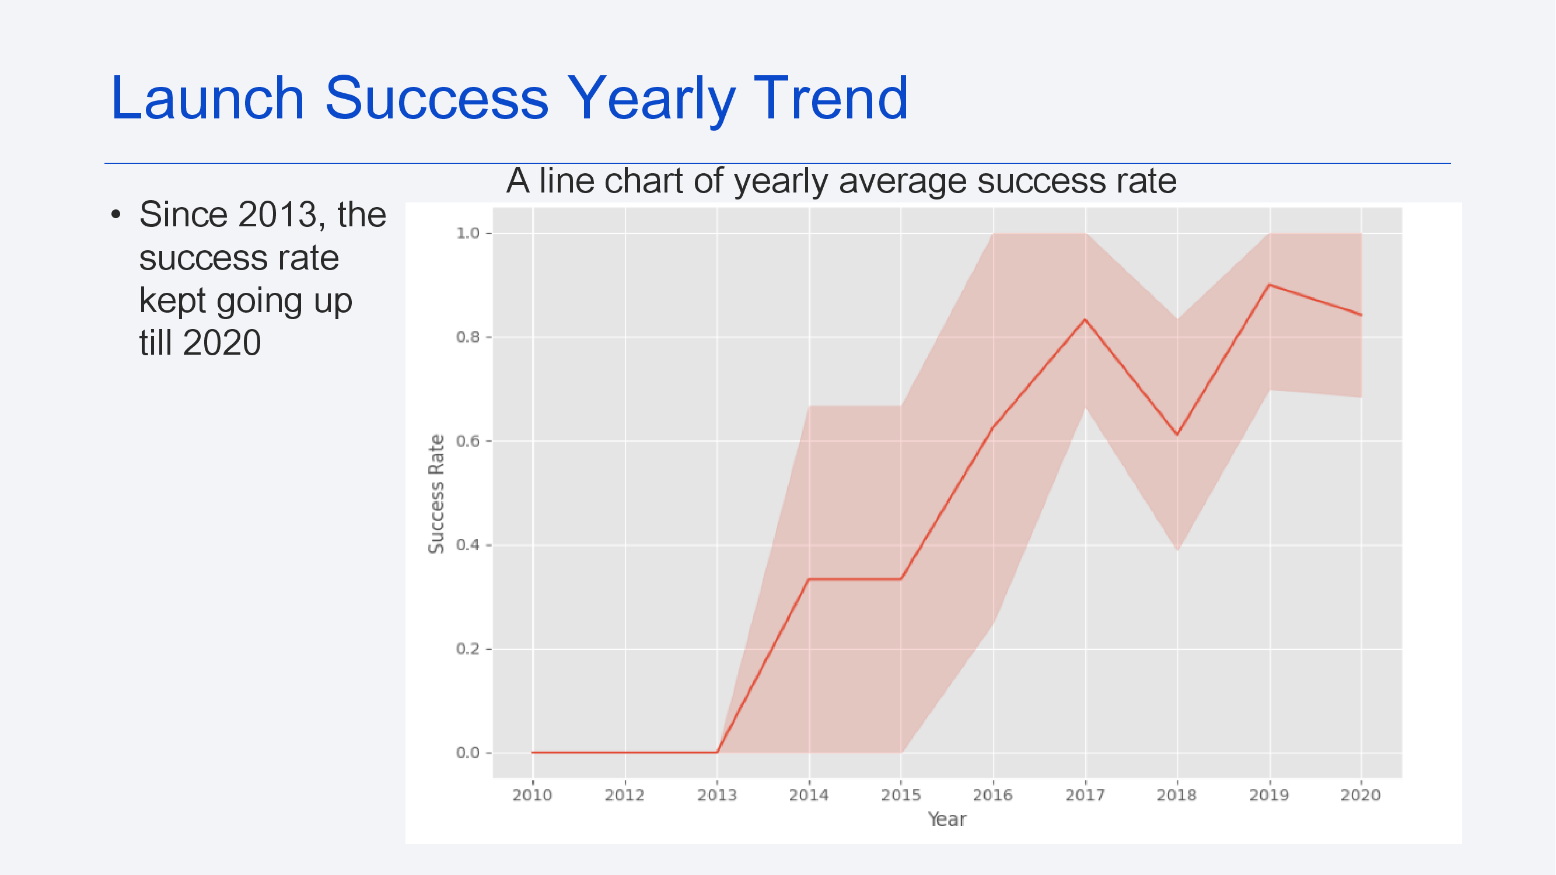

Slide 33
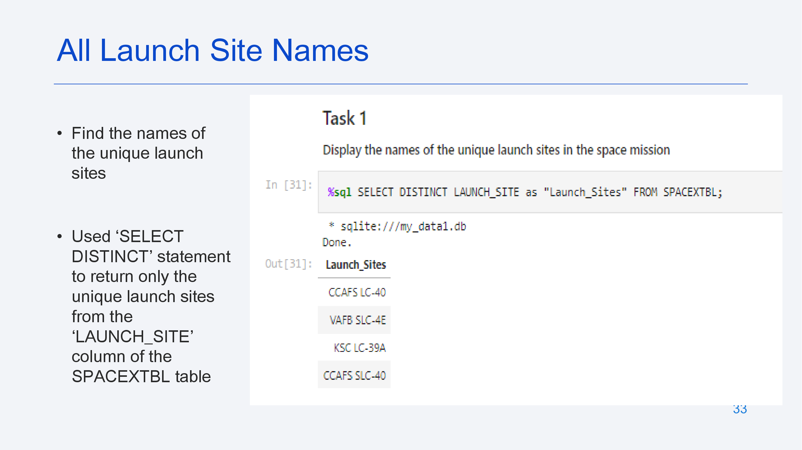

Slide 34
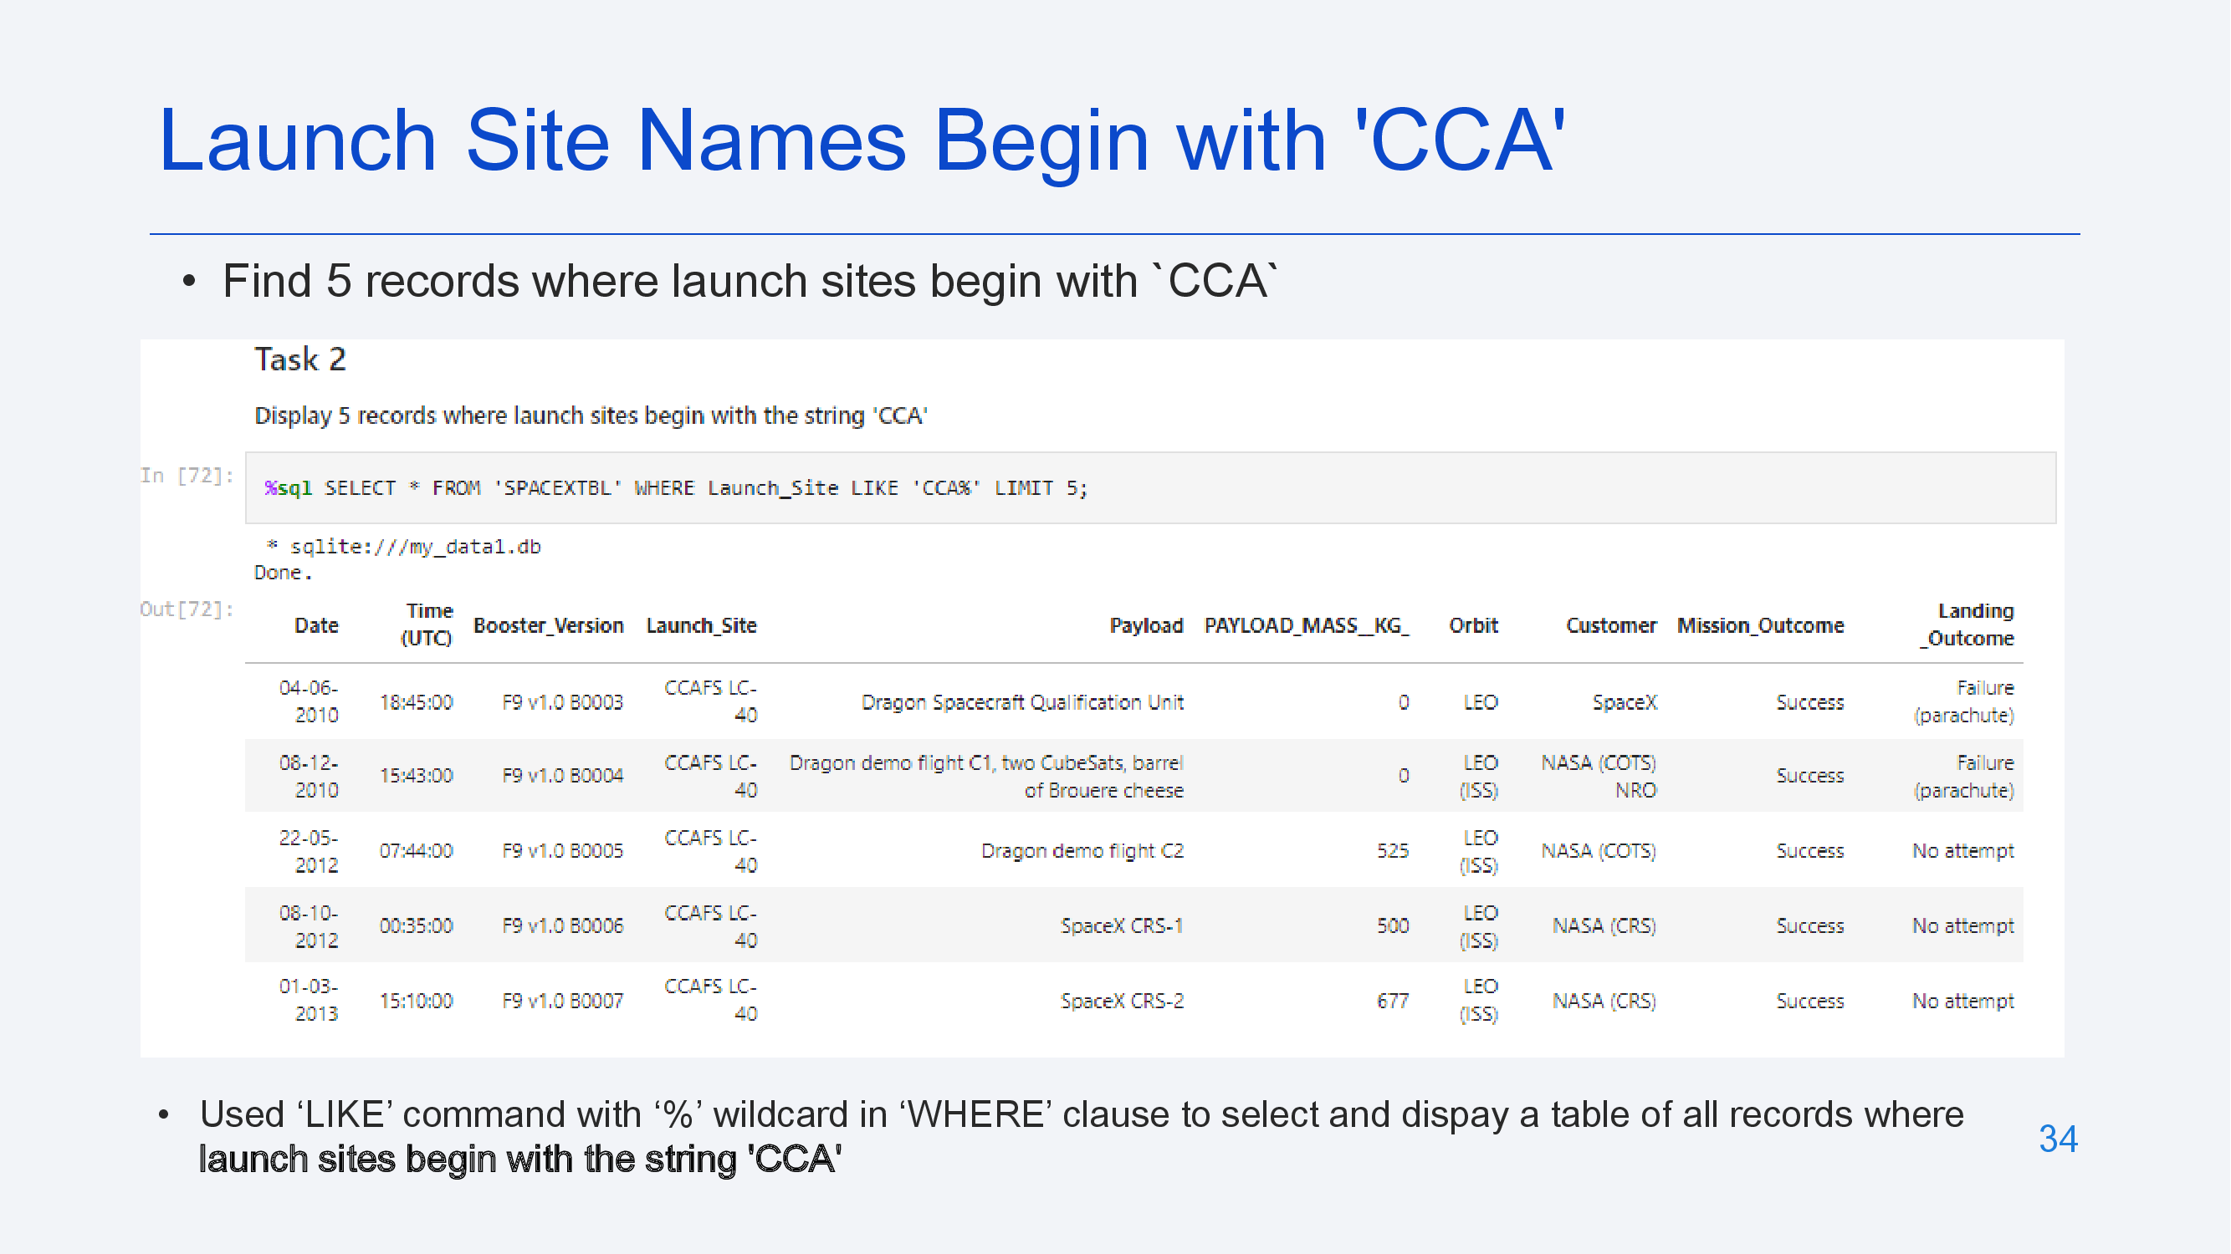

Slide 35
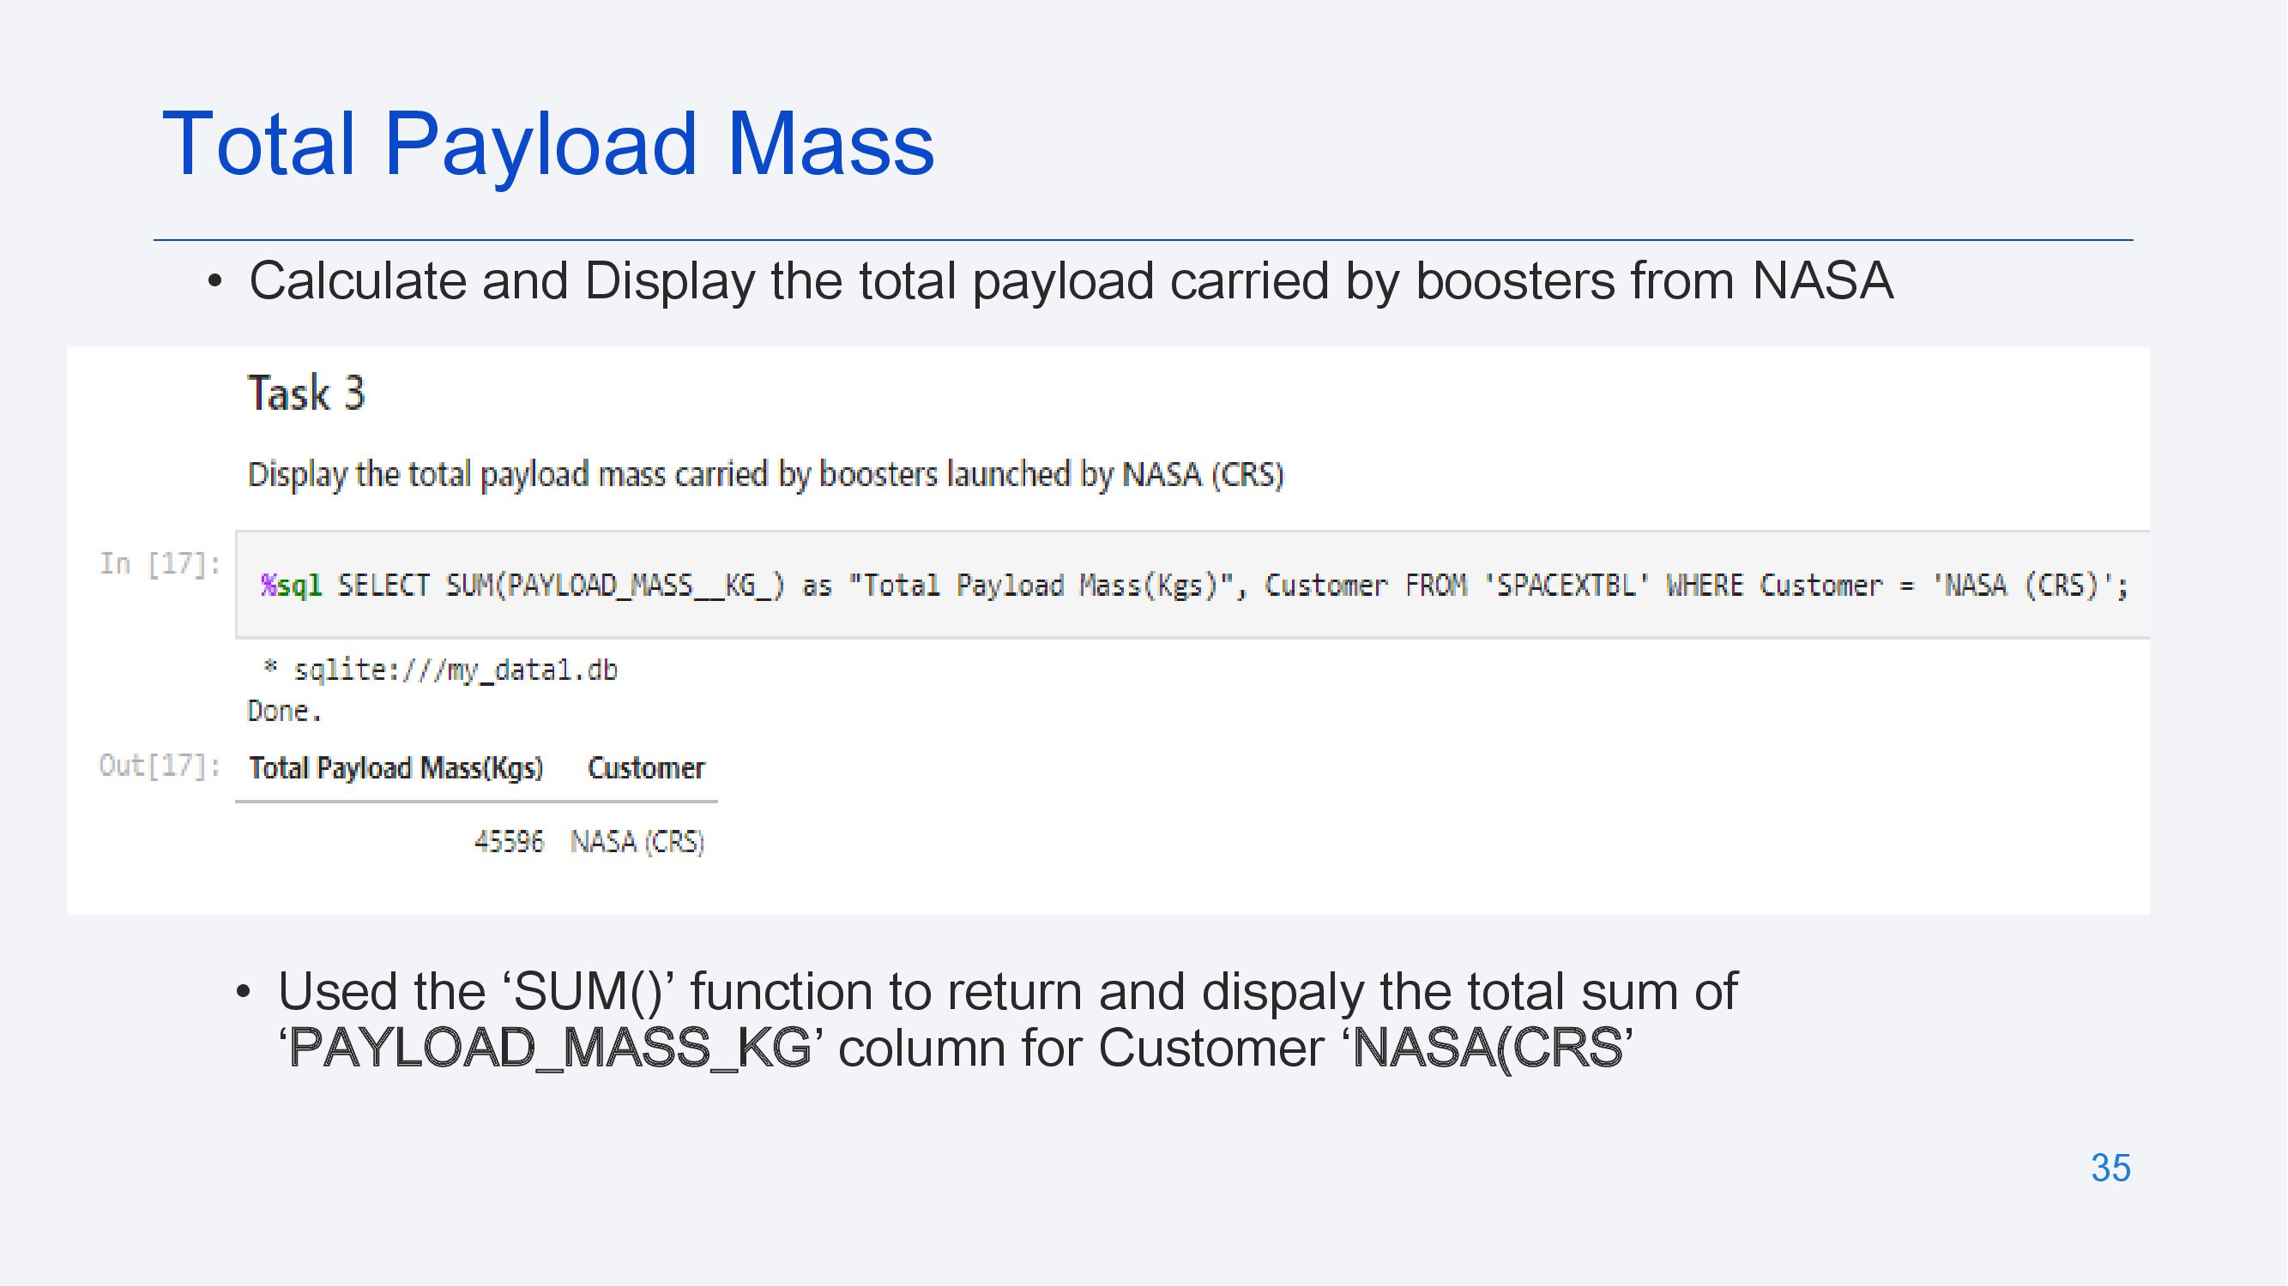

Slide 36
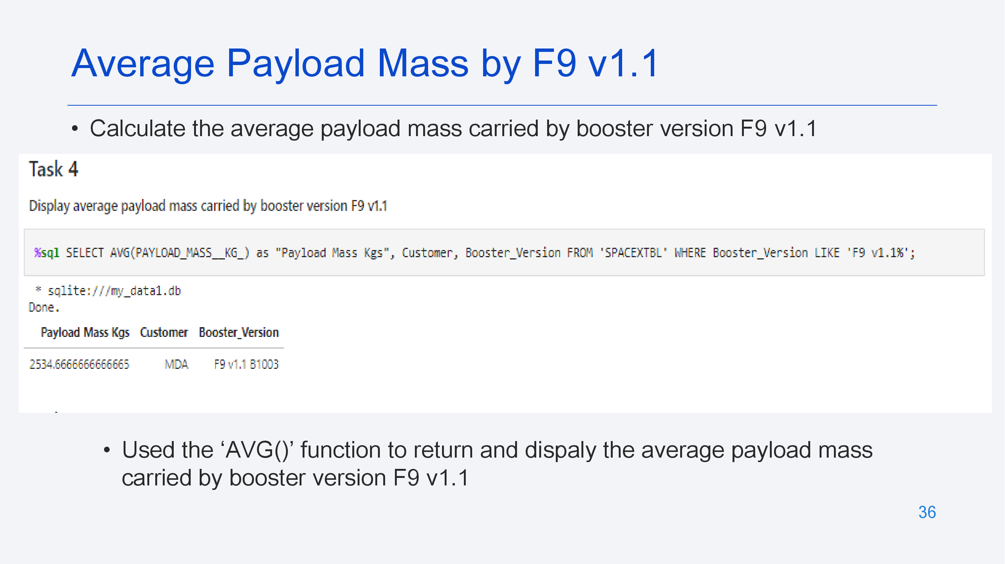

Slide 37
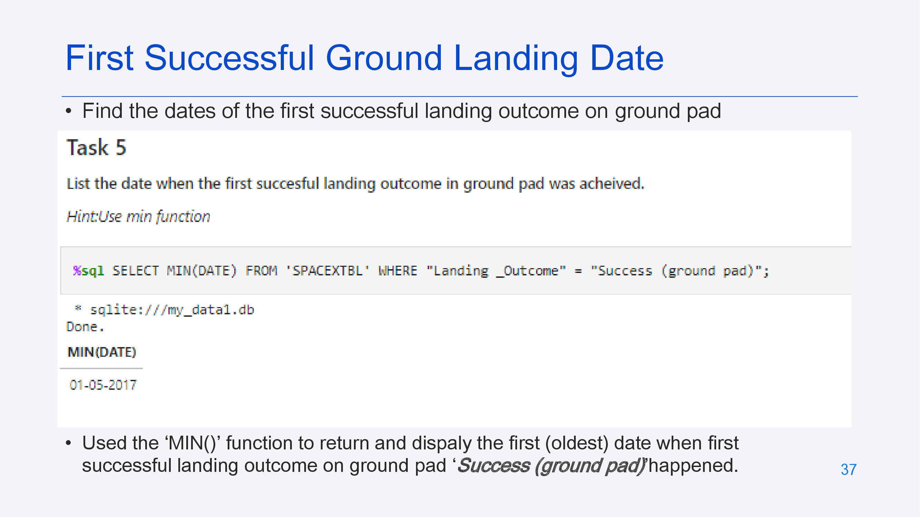

Slide 38
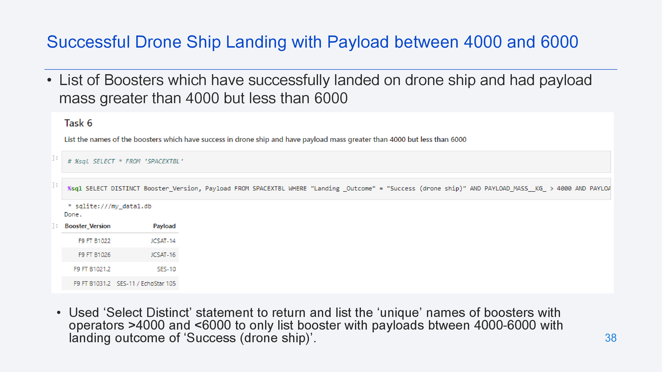

Slide 39
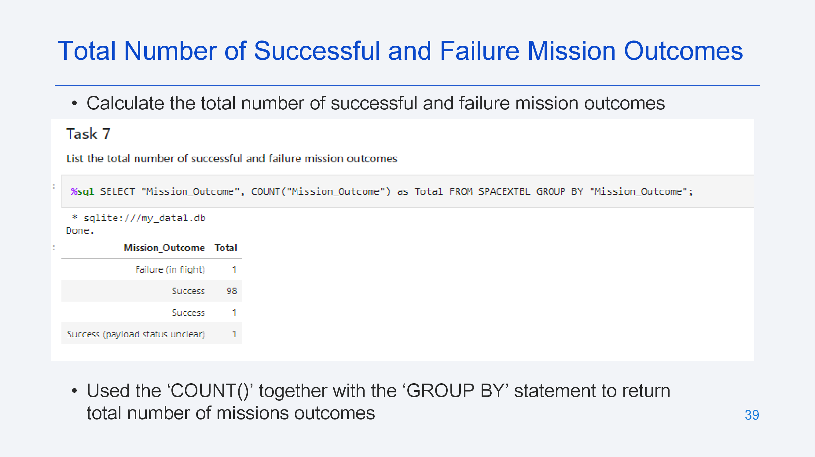

Slide 40
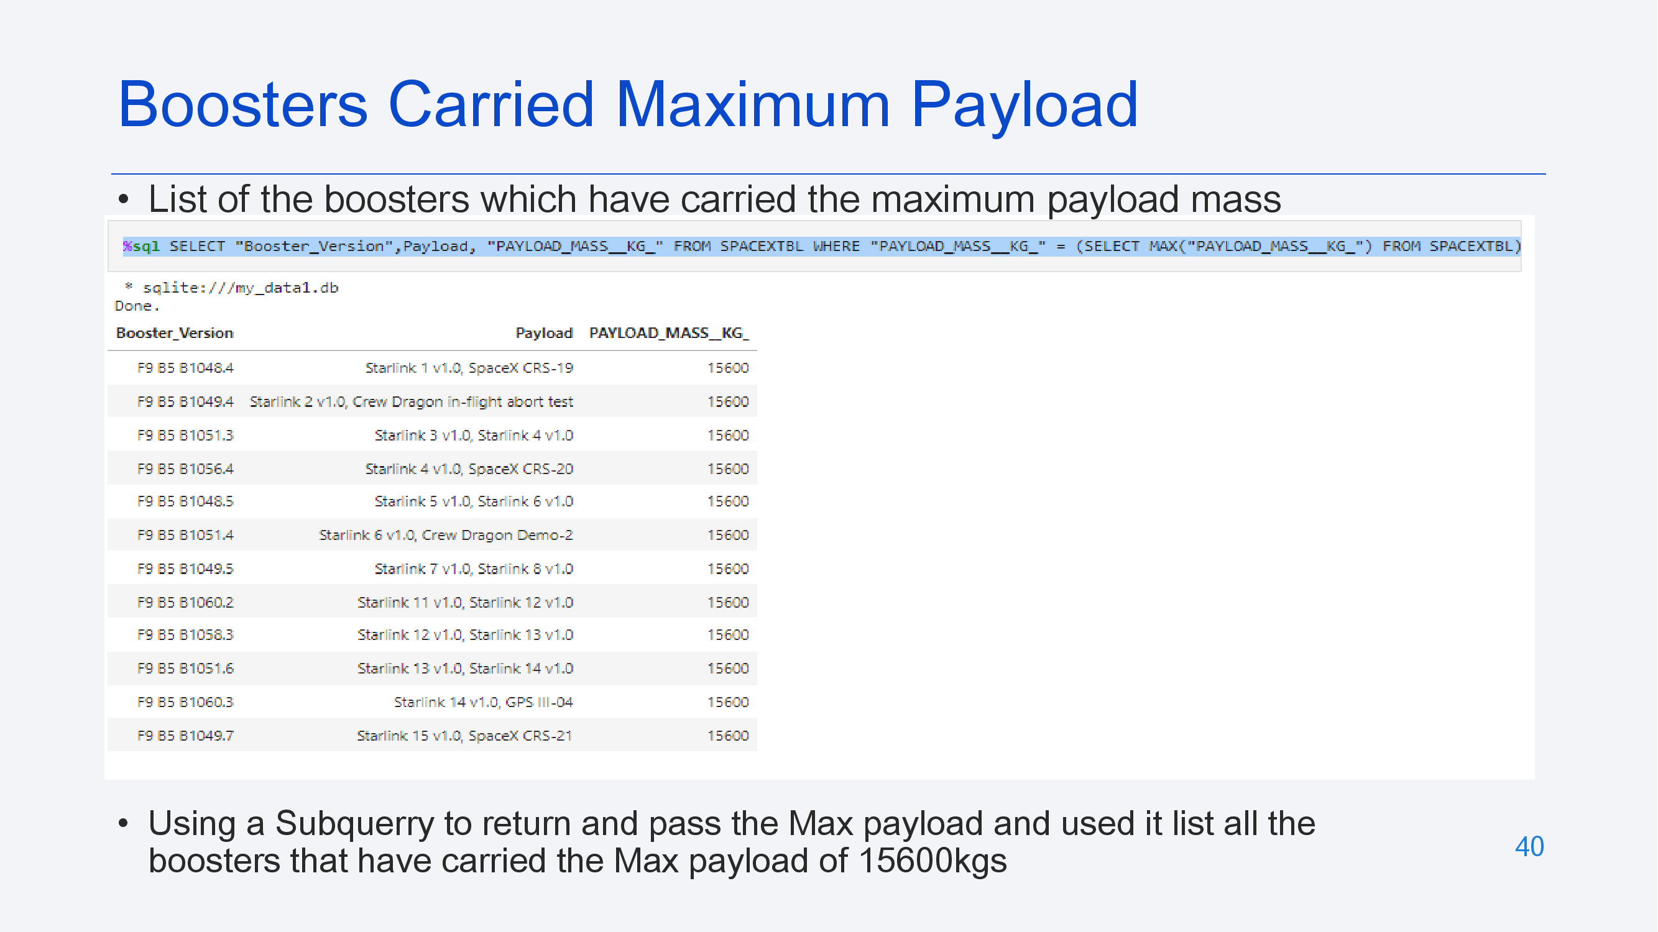

Slide 41
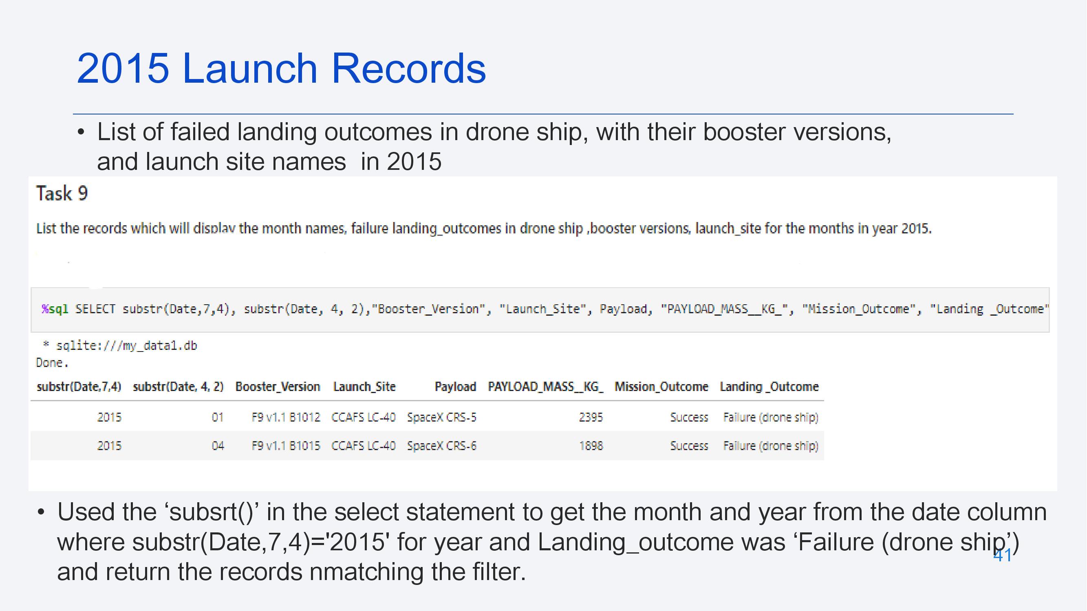

Slide 42
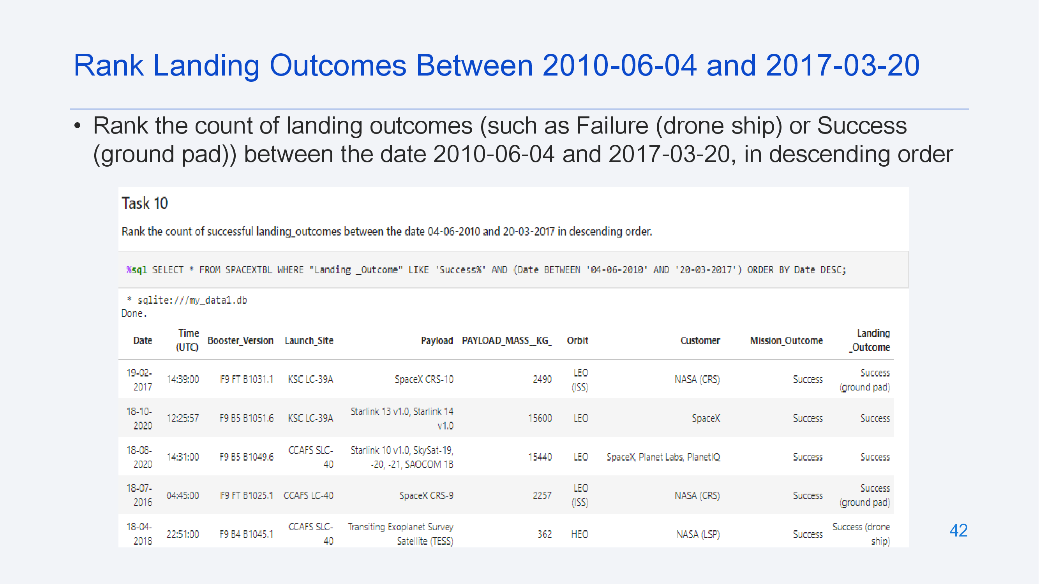

Slide 43
Launch Sites
Proximity Analysis

Slide 44
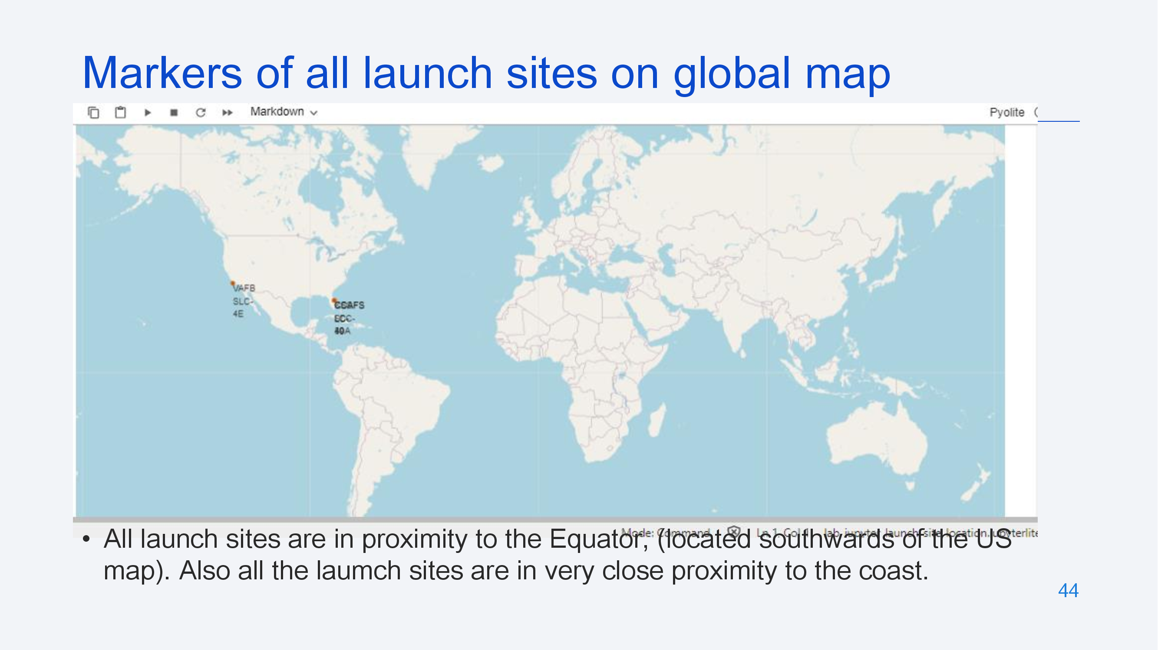

Slide 45
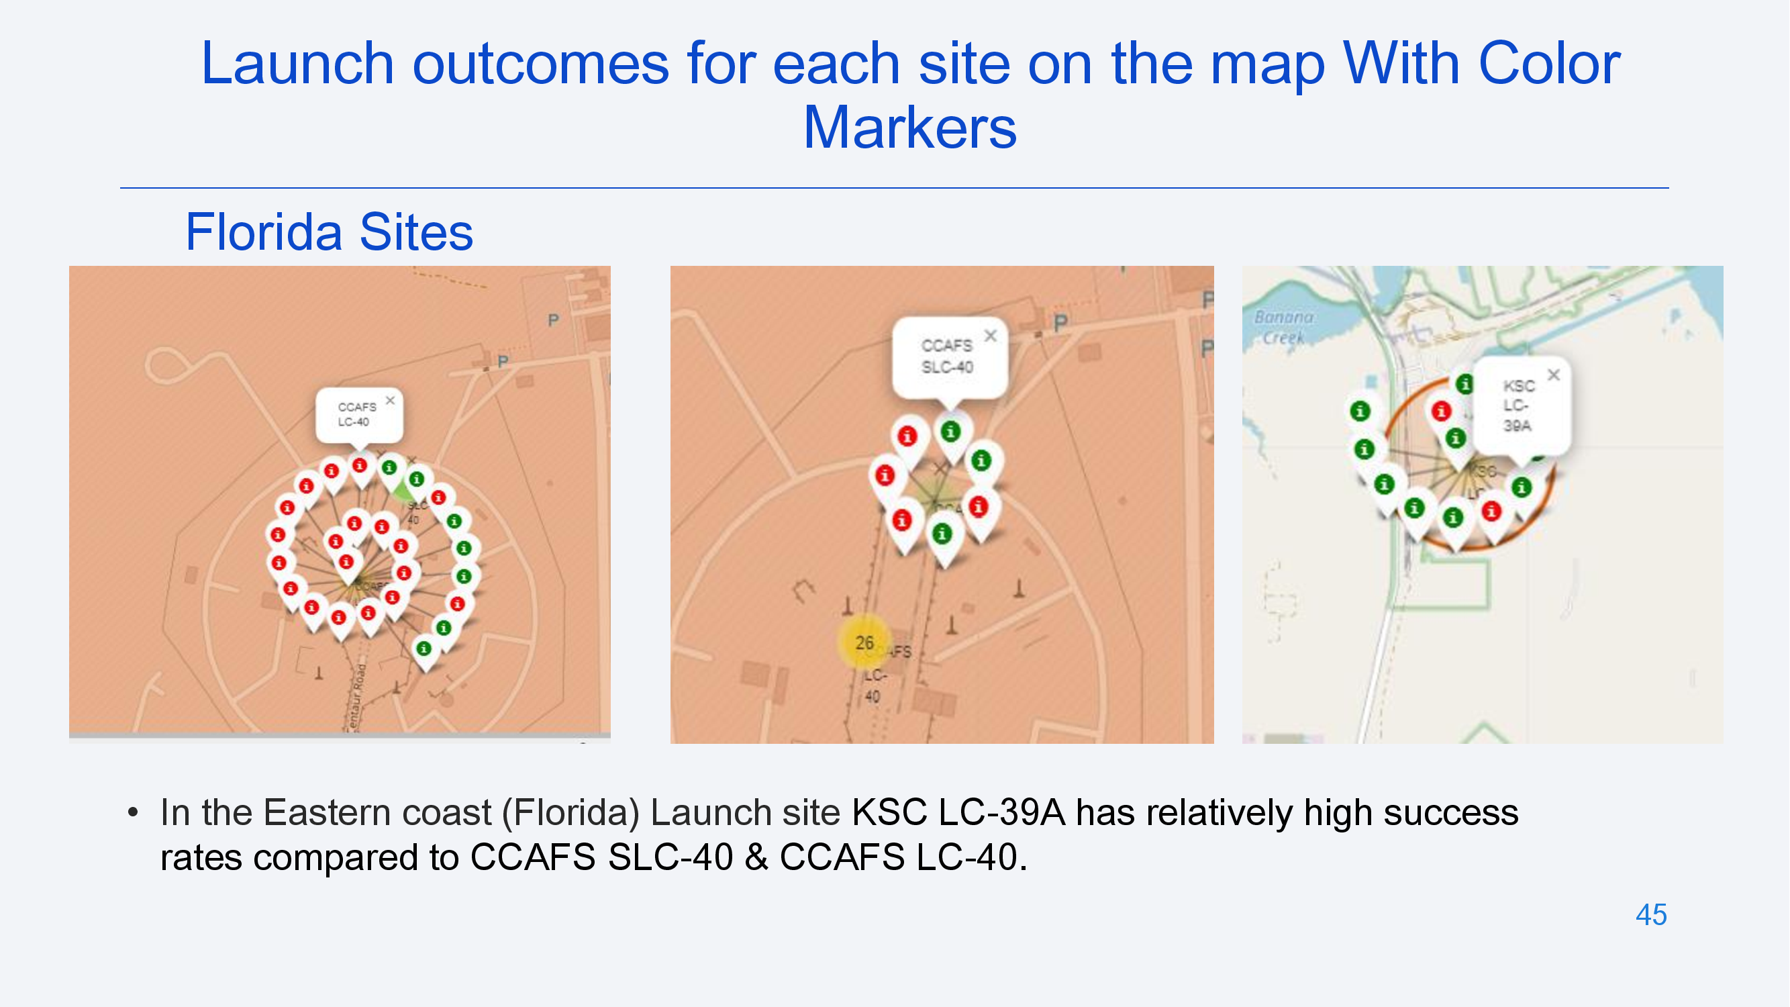

Slide 46
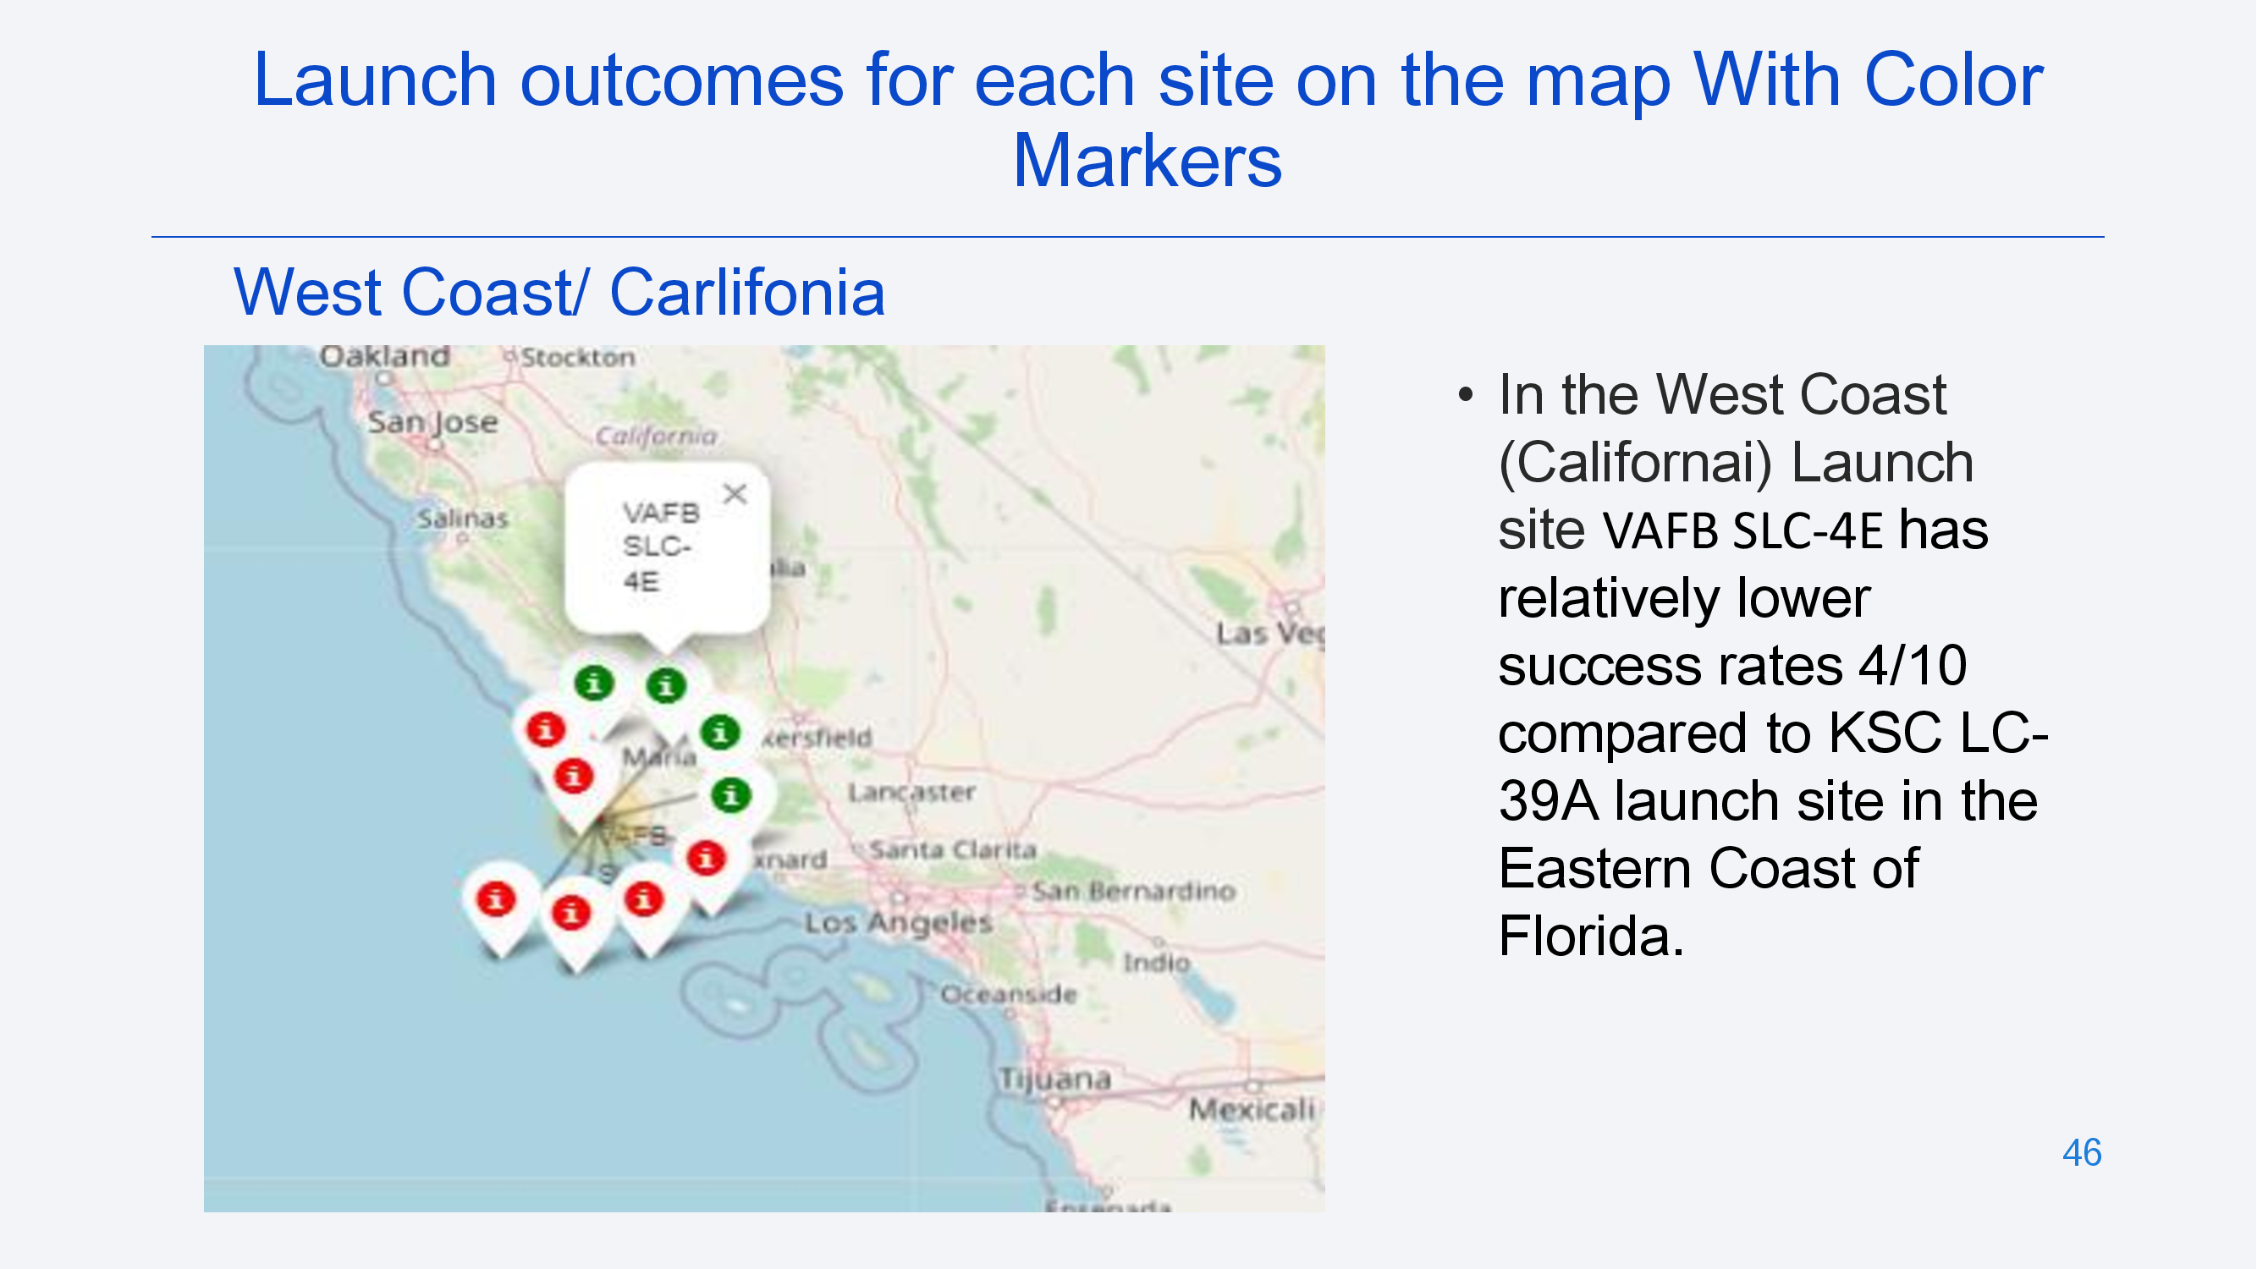

Slide 47
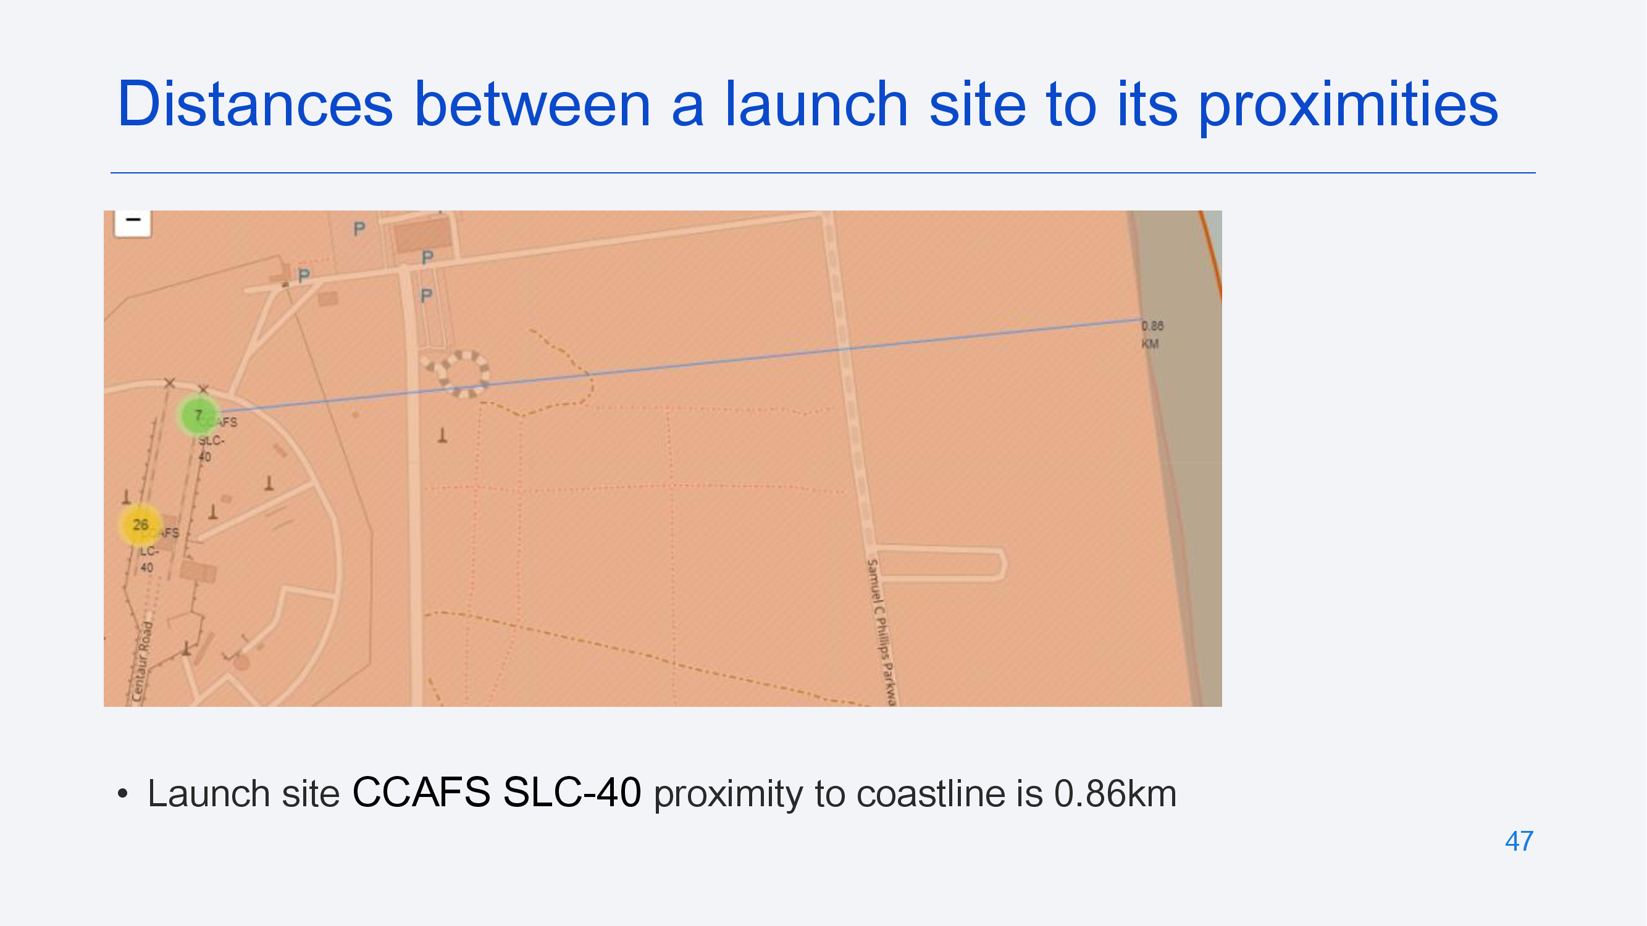

Slide 48
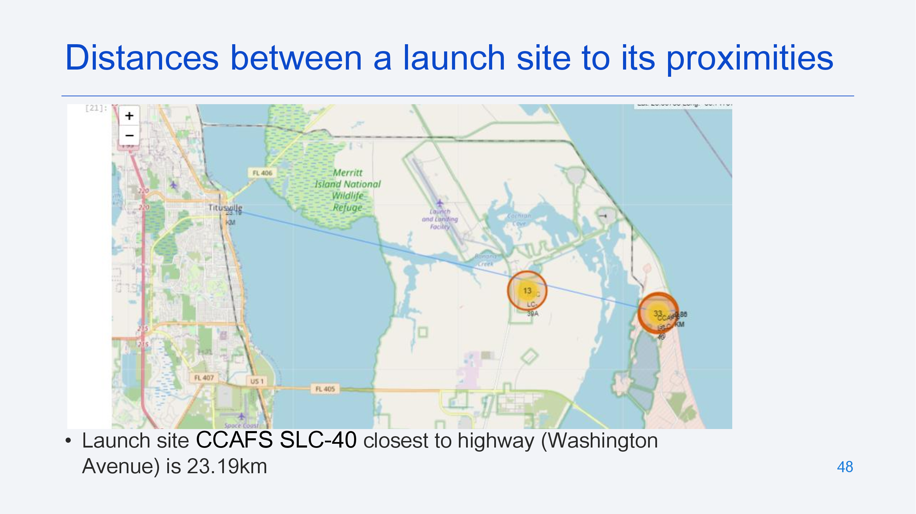

Slide 49
Build a Dashboard with Plotly Dash

Slide 50
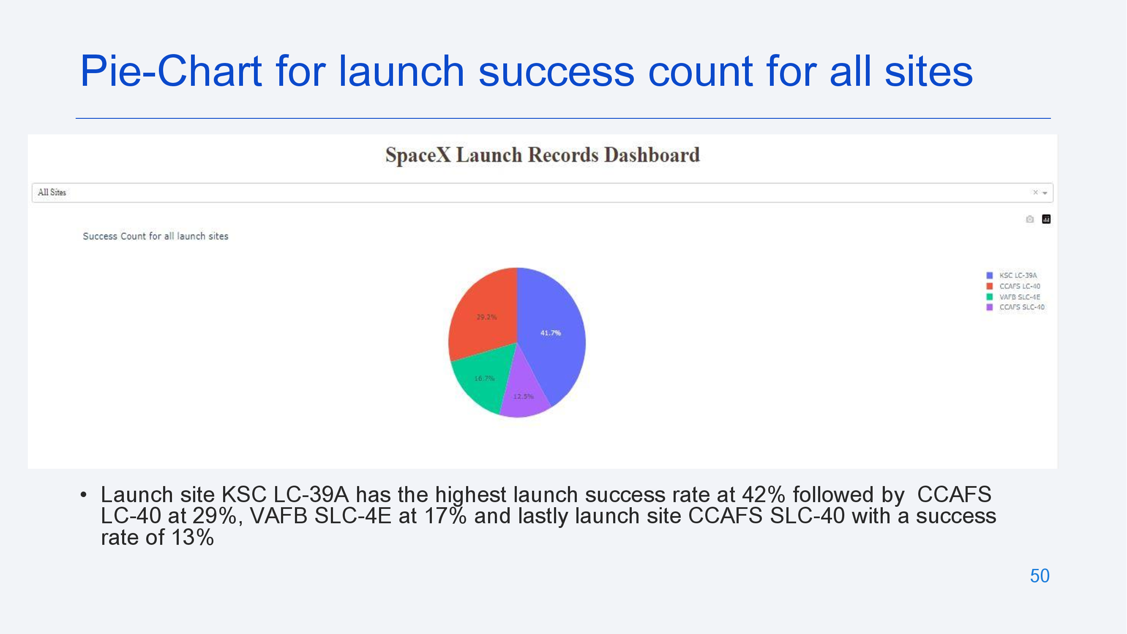

Slide 51
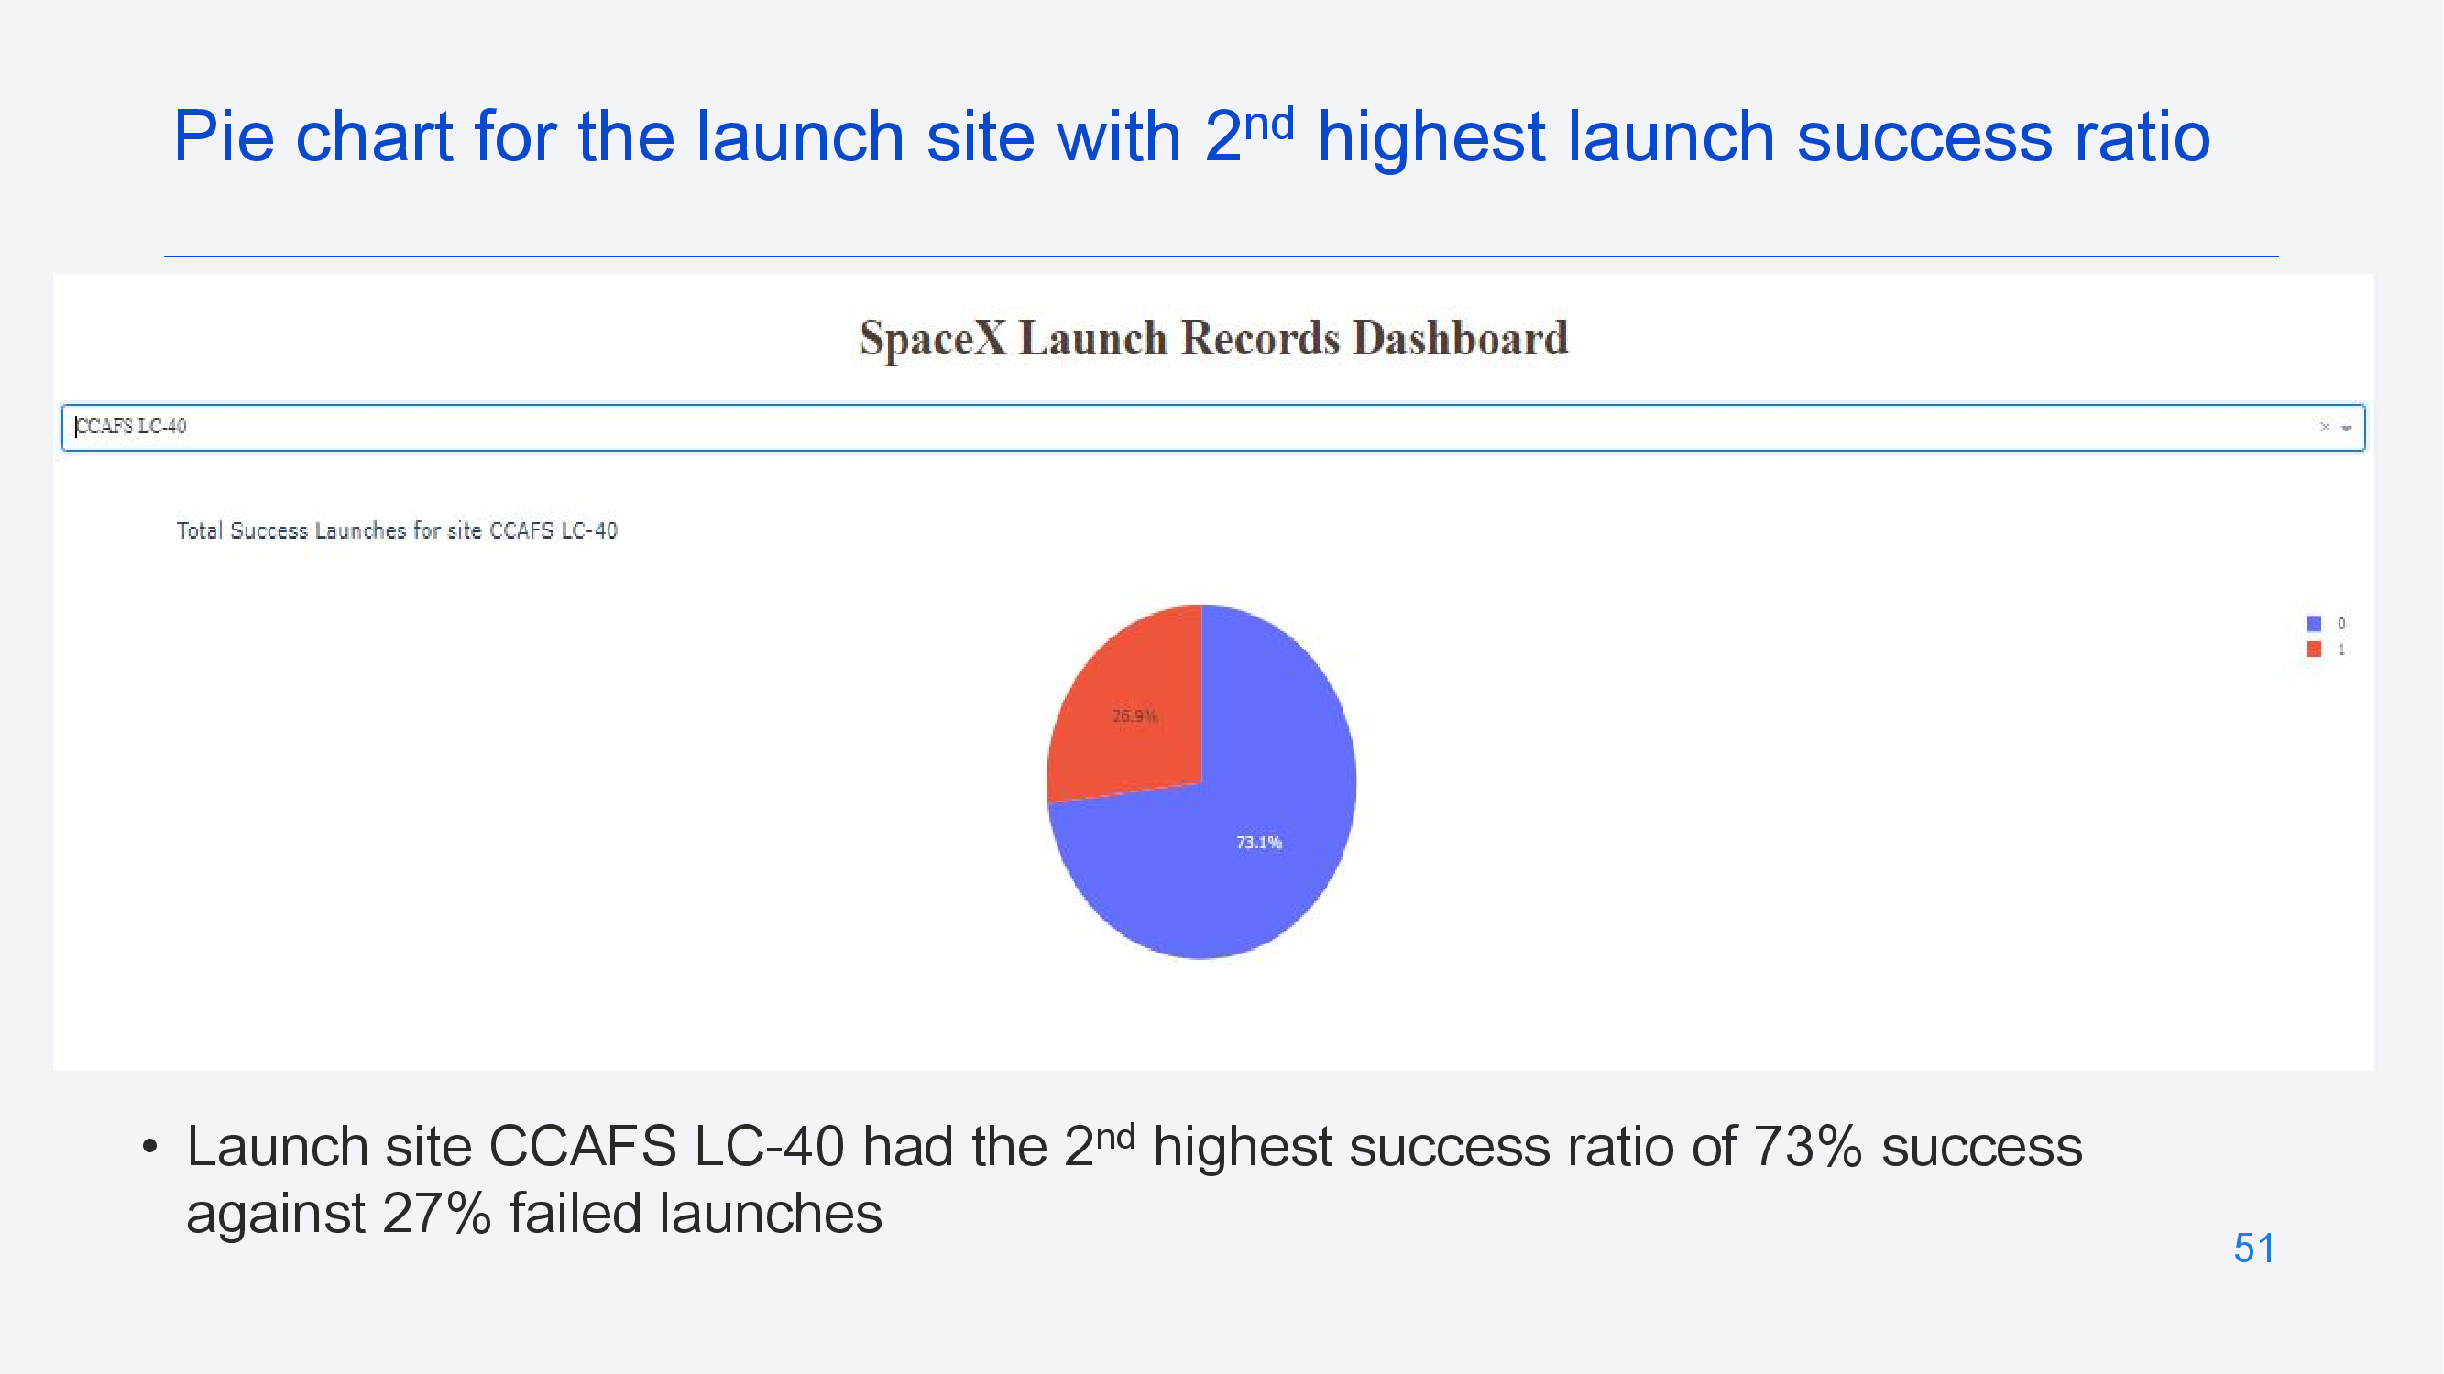

Slide 52
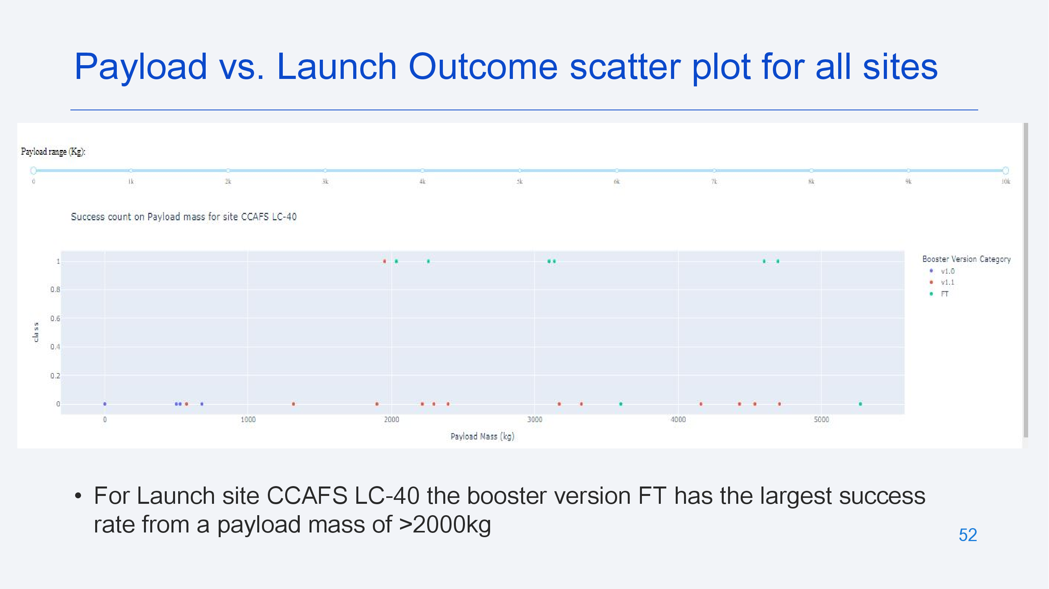

Slide 53
Predictive Analysis: Classification

Slide 54
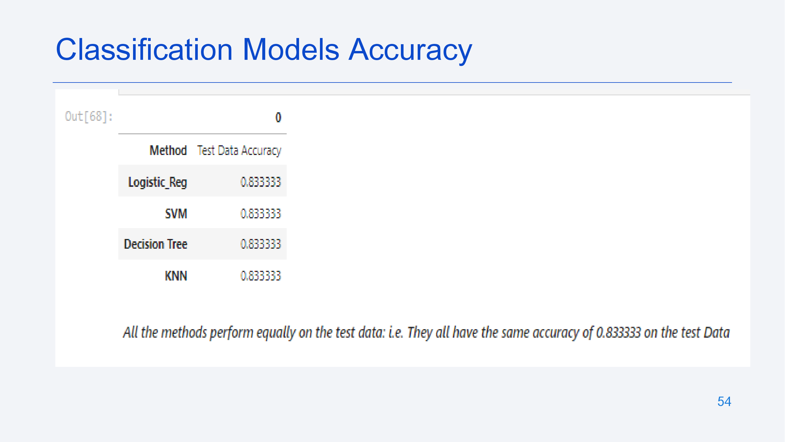

Slide 55
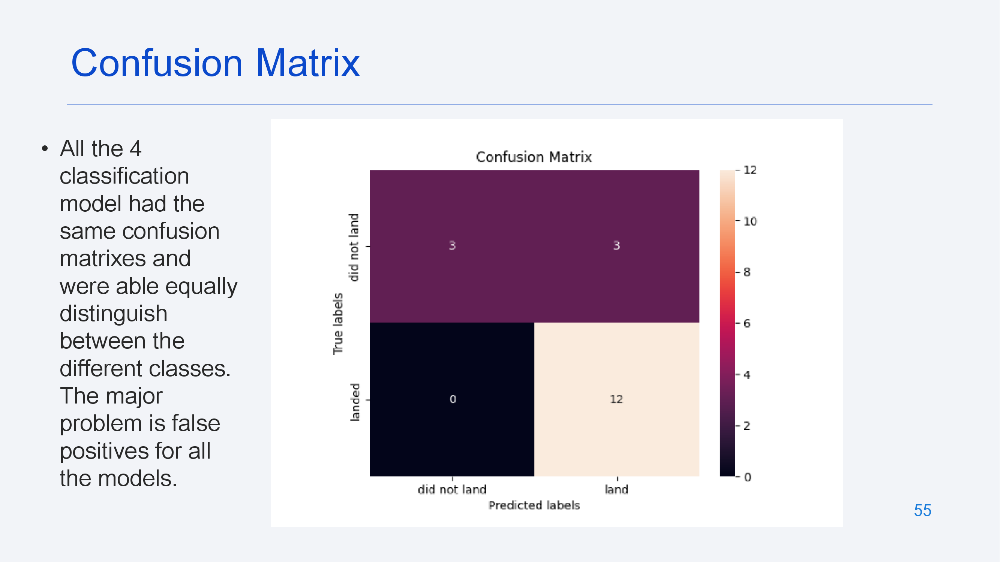

Slide 56
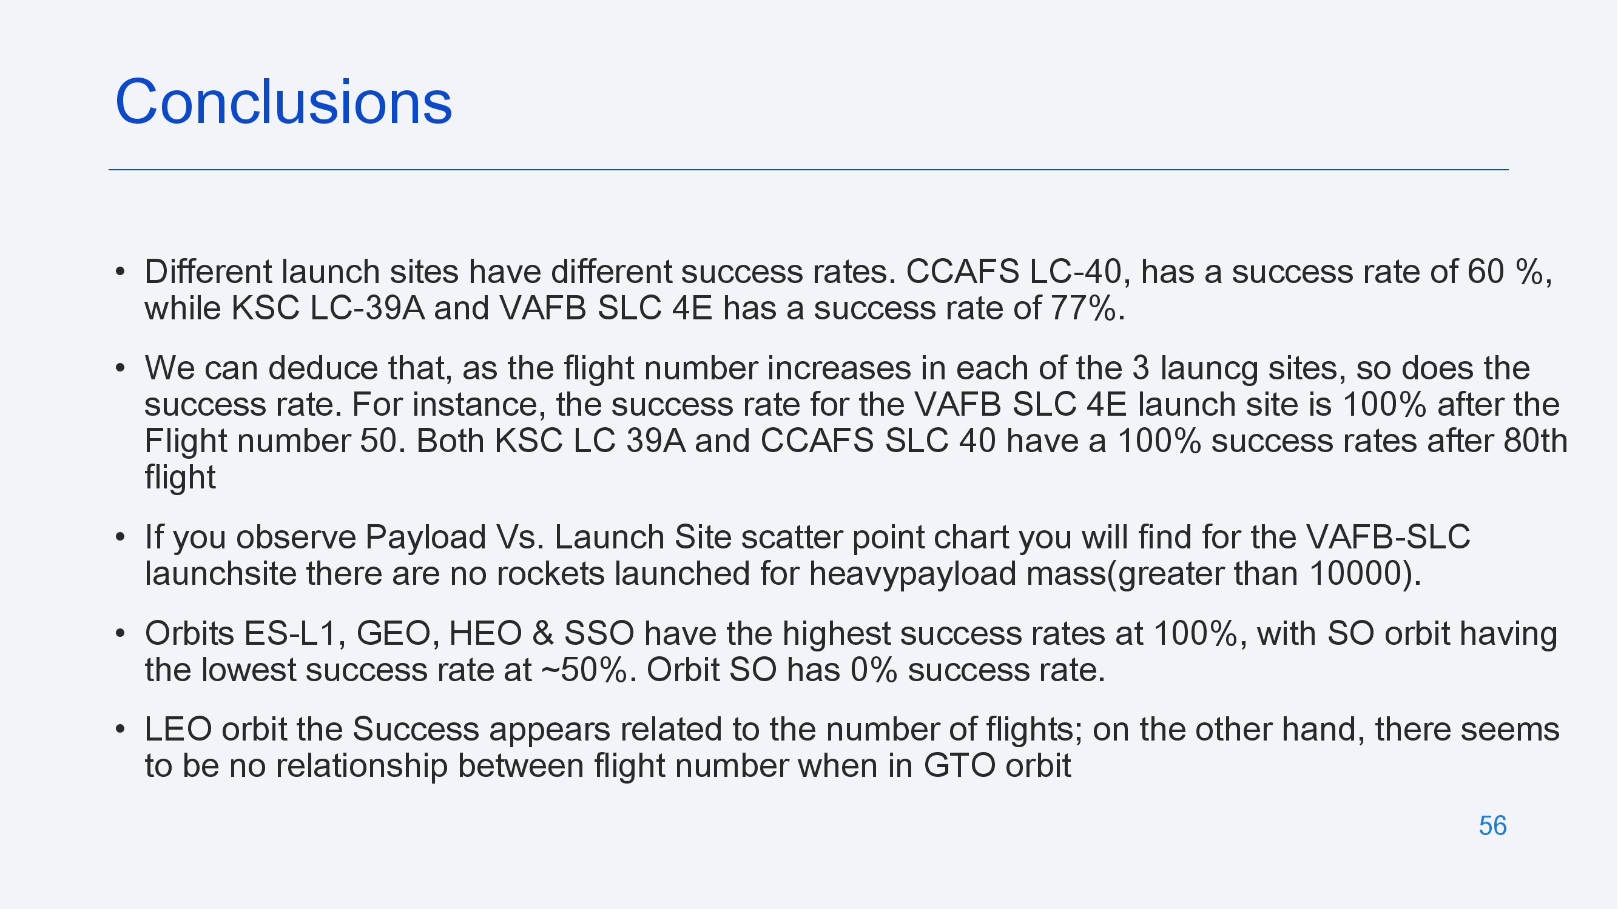

Slide 57
